Slide 1
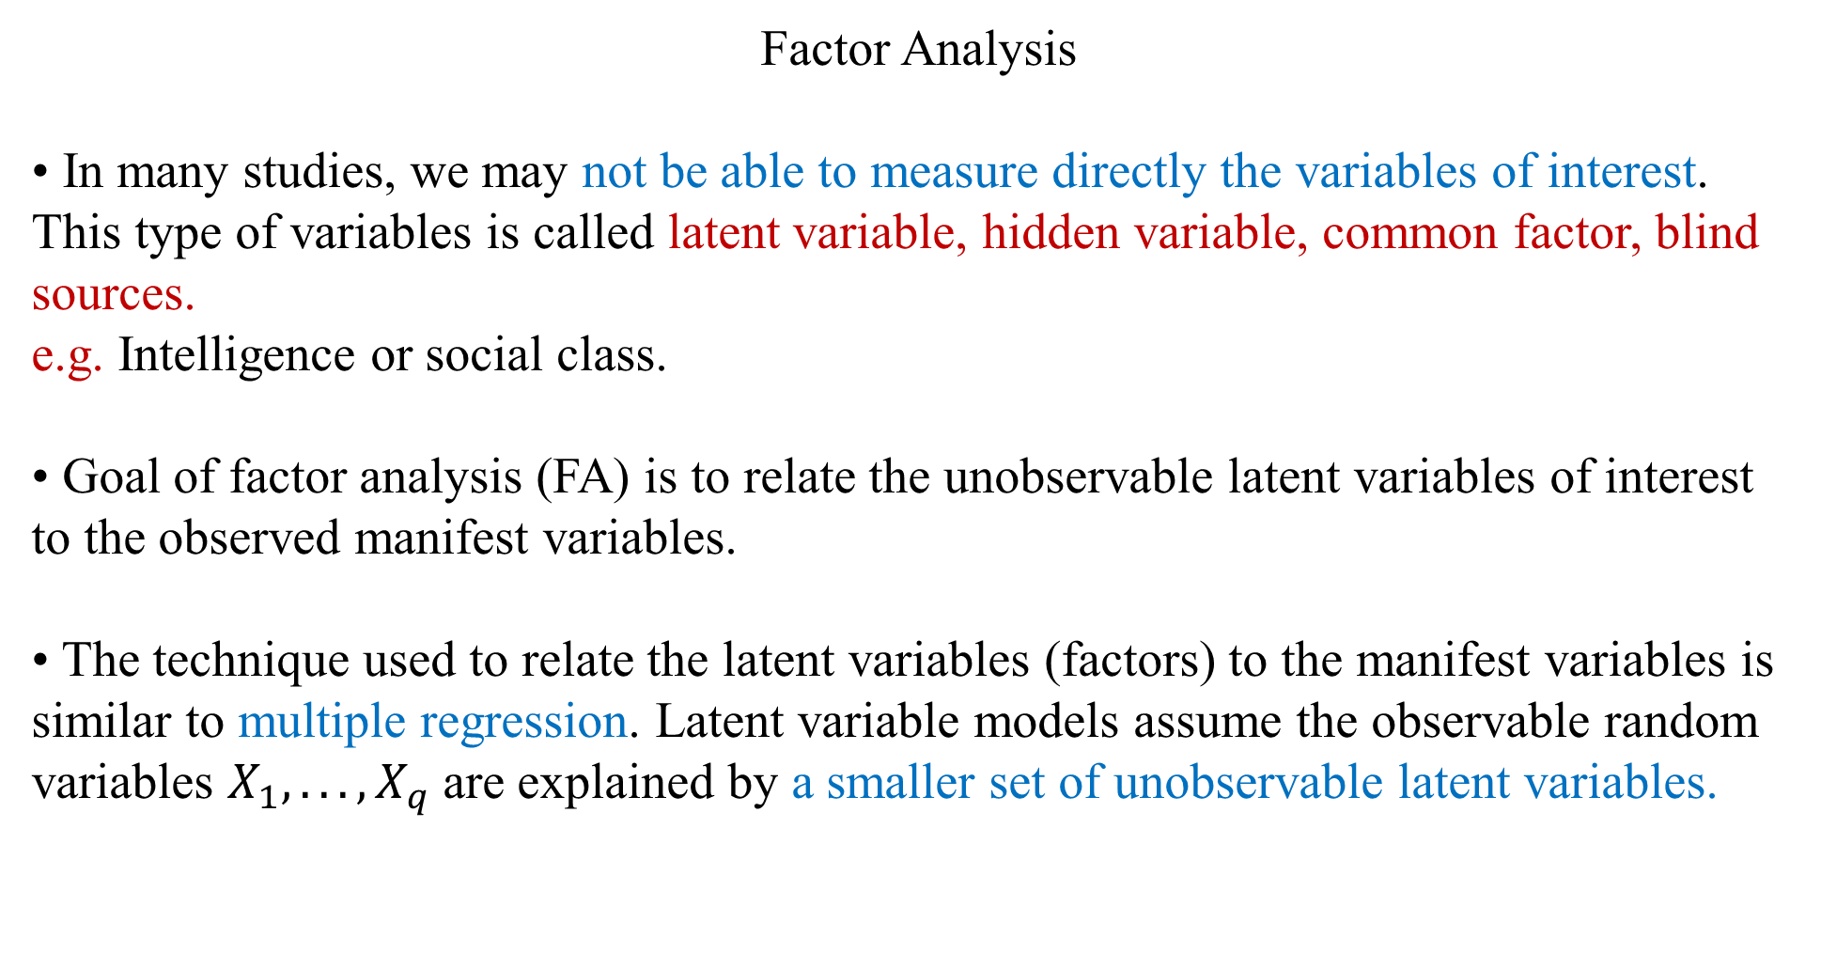
Factor Analysis
• In many studies, we may not be able to measure directly the variables of interest. This type of variables is called latent variable, hidden variable, common factor, blind sources.
e.g. Intelligence or social class.
• Goal of factor analysis (FA) is to relate the unobservable latent variables of interest to the observed manifest variables.
• The technique used to relate the latent variables (factors) to the manifest variables is similar to multiple regression. Latent variable models assume the observable random variables $X_{1}, . . . , X_{q}$are explained by a smaller set of unobservable latent variables.

Slide 2
Example: Intelligence Study
• The Exam scores for 10 psychology students are collected. The multivariate data set consisted of 8 variables: These 6 test scores, plus “age” and “years of education.”
• Based on the observed variables, we may want to identify certain underlying factors that cause the individuals to differ.
• Is there a “general intelligence” factor? Is there a “language ability” factor? Is there a “math ability” factor? Factor analysis can help us answer these questions.
subject | age | # year ed | maths | english | history | geography | chemistry | physics
1 | 18 | 12 | 60 | 70 | 75 | 58 | 53 | 42
2 | 20 | 11 | 80 | 65 | 66 | 75 | 70 | 76
3 | 29 | 14 | 53 | 60 | 50 | 48 | 45 | 43
4 | 25 | 13 | 85 | 79 | 71 | 77 | 68 | 79
5 | 22 | 10 | 45 | 80 | 80 | 84 | 44 | 46
6 | 24 | 14 | 85 | 62 | 84 | 92 | 58 | 64
7 | 17 | 11 | 57 | 89 | 59 | 86 | 58 | 58
8 | 16 | 11 | 59 | 58 | 68 | 57 | 79 | 69
9 | 24 | 14 | 80 | 92 | 73 | 89 | 84 | 58
10 | 19 | 12 | 76 | 67 | 49 | 67 | 51 | 35

Slide 3
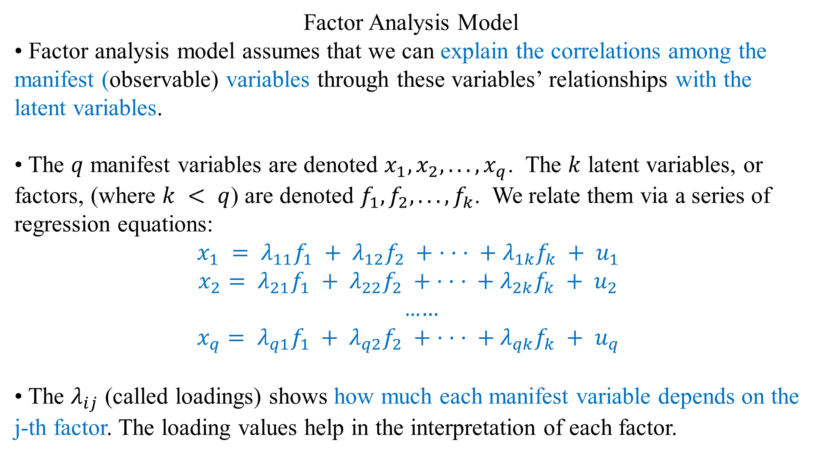
Factor Analysis Model
• Factor analysis model assumes that we can explain the correlations among the manifest (observable) variables through these variables’ relationships with the latent variables.
• The $q$ manifest variables are denoted $x_{1}, x_{2}, . . ., x_{q}$. The $k$ latent variables, or factors, (where $k < q$) are denoted $f_{1}, f_{2}, . . ., f_{k}$. We relate them via a series of regression equations:
$$x_{1} = λ_{11}f_{1} + λ_{12}f_{2} + · · · + λ_{1k}f_{k} + u_{1}$$
$$x_{2}= λ_{21}f_{1} + λ_{22}f_{2} + · · · + λ_{2k}f_{k} + u_{2}$$
…$…$
$$x_{q}= λ_{q1}f_{1} + λ_{q2}f_{2} + · · · + λ_{qk}f_{k} + u_{q}$$
• The $λ_{ij}$ (called loadings) shows how much each manifest variable depends on the j-th factor. The loading values help in the interpretation of each factor.

Slide 4
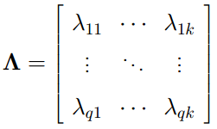
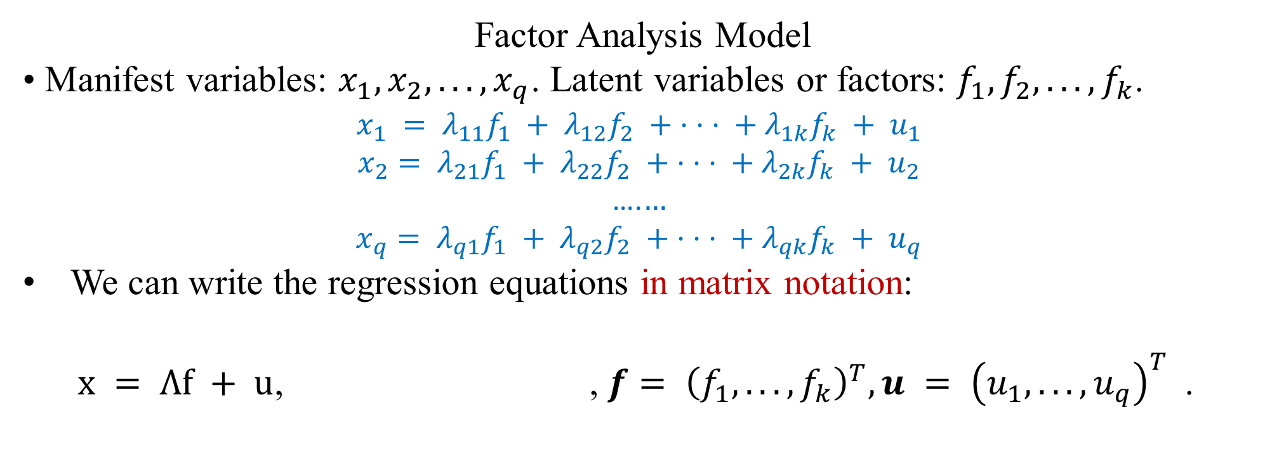
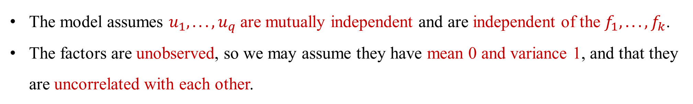
Factor Analysis Model
• Manifest variables: $x_{1}, x_{2}, . . ., x_{q}$. Latent variables or factors: $f_{1}, f_{2}, . . ., f_{k}$.
$$x_{1} = λ_{11}f_{1} + λ_{12}f_{2} + · · · + λ_{1k}f_{k} + u_{1}$$
$$x_{2}= λ_{21}f_{1} + λ_{22}f_{2} + · · · + λ_{2k}f_{k} + u_{2}$$
….$…$
$$x_{q}= λ_{q1}f_{1} + λ_{q2}f_{2} + · · · + λ_{qk}f_{k} + u_{q}$$
We can write the regression equations in matrix notation:
$x = Λf + u$, , $f= {\left(f_{1}, . . ., f_{k}\right)}^{T}, u = {\left(u_{1}, . . ., u_{q}\right)}^{T}$.
The model assumes $u_{1}, . . ., u_{q}$are mutually independent and are independent of the $f_{1}, . . ., f_{k}$.
The factors are unobserved, so we may assume they have mean 0 and variance 1, and that they are uncorrelated with each other.

Slide 5
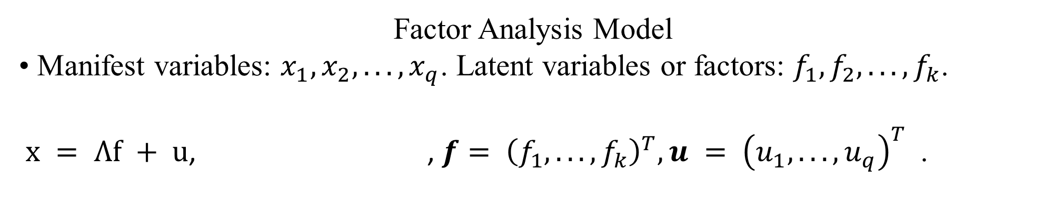
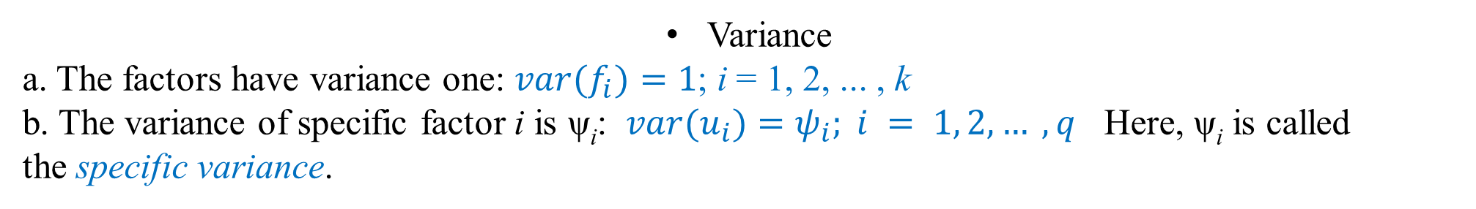
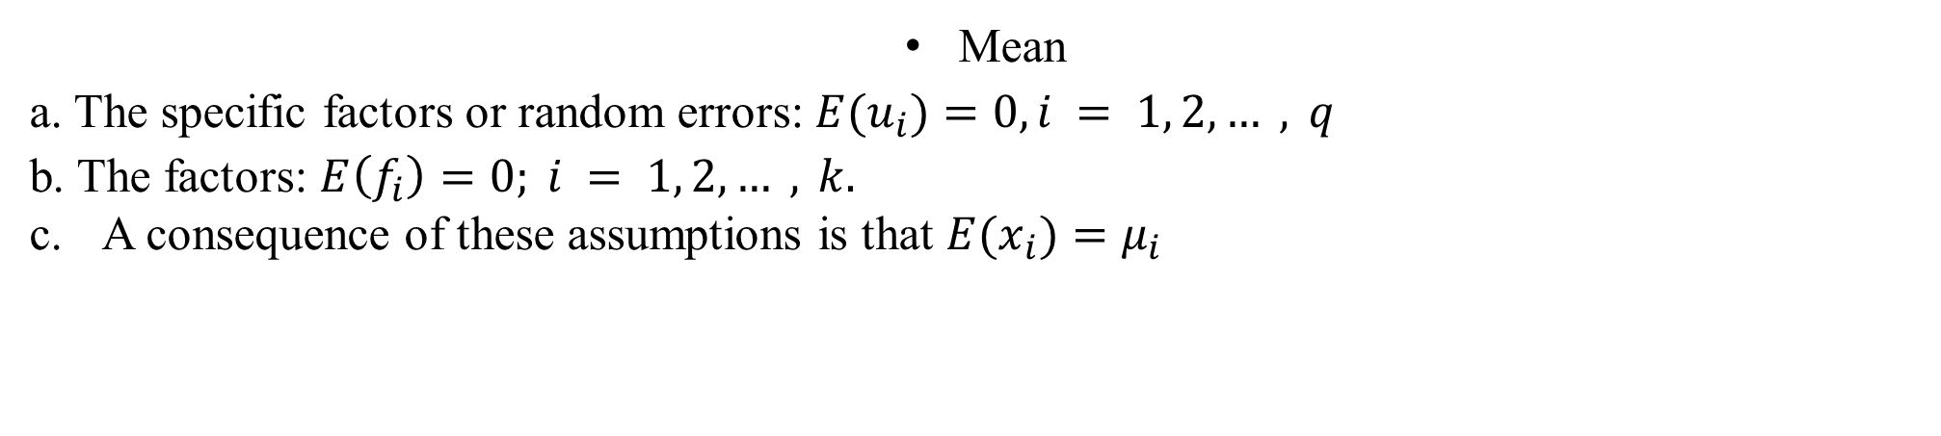
Factor Analysis Model
• Manifest variables: $x_{1}, x_{2}, . . ., x_{q}$. Latent variables or factors: $f_{1}, f_{2}, . . ., f_{k}$.
$x = Λf + u$, , $f= {\left(f_{1}, . . ., f_{k}\right)}^{T}, u = {\left(u_{1}, . . ., u_{q}\right)}^{T}$.
Mean
a. The specific factors or random errors: $E(u_{i})=0, i = 1, 2, … , q$
b. The factors: $E\left(f_{i}\right)=0; i = 1, 2, … , k.$
A consequence of these assumptions is that $E(x_{i})=μ_{i}$
Variance
a. The factors have variance one: $var(f_{i})=1$; i = 1, 2, ... , k
b. The variance of specific factor i is ψ_{i}: $var(u_{i})=ψ_{i}; i = 1, 2, … , q$ Here, ψ_{i} is called the specific variance.

Slide 6
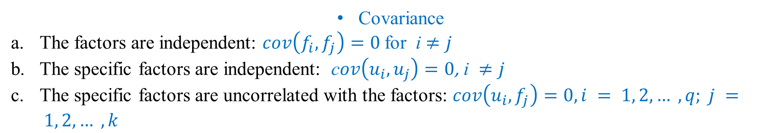
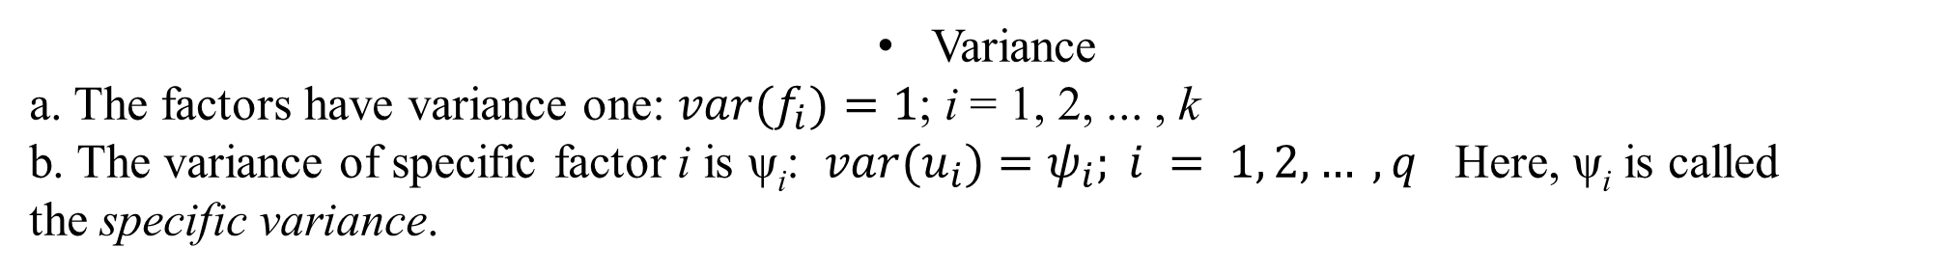
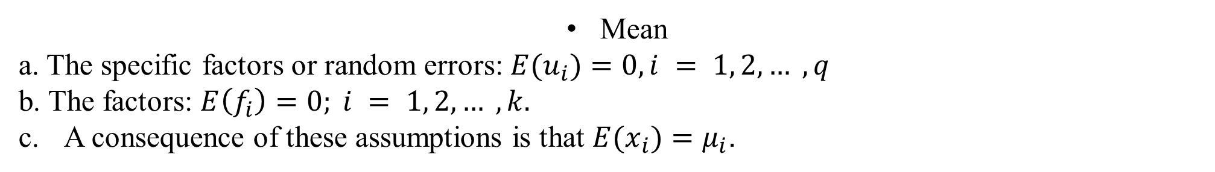
$x = Λf + u$, , $f= {\left(f_{1}, . . ., f_{k}\right)}^{T}, u = {\left(u_{1}, . . ., u_{q}\right)}^{T}$.
Mean
a. The specific factors or random errors: $E(u_{i})=0, i = 1, 2, … , q$
b. The factors: $E\left(f_{i}\right)=0; i = 1, 2, … , k.$
A consequence of these assumptions is that $E(x_{i})=μ_{i}$.
Variance
a. The factors have variance one: $var(f_{i})=1$; i = 1, 2, ... , k
b. The variance of specific factor i is ψ_{i}: $var(u_{i})=ψ_{i}; i = 1, 2, … , q$ Here, ψ_{i} is called the specific variance.
Covariance
The factors are independent: $cov\left(f_{i}, f_{j}\right)=0$for i $≠j$
The specific factors are independent: c$ov\left(u_{i}, u_{j}\right)=0\text{,} \text{i} ≠j$
The specific factors are uncorrelated with the factors: $cov\left(u_{i},f_{j}\right)=0,i = 1, 2, … , q; j = 1, 2, … , k$

Slide 7
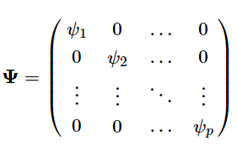
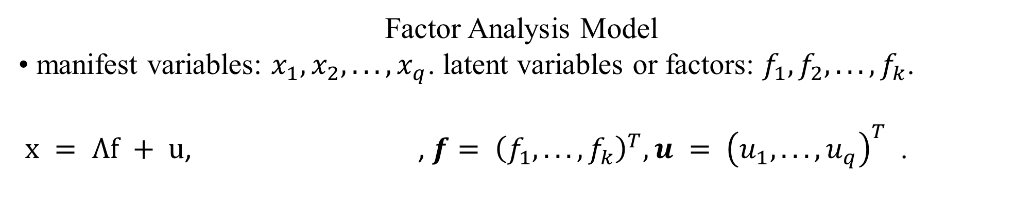
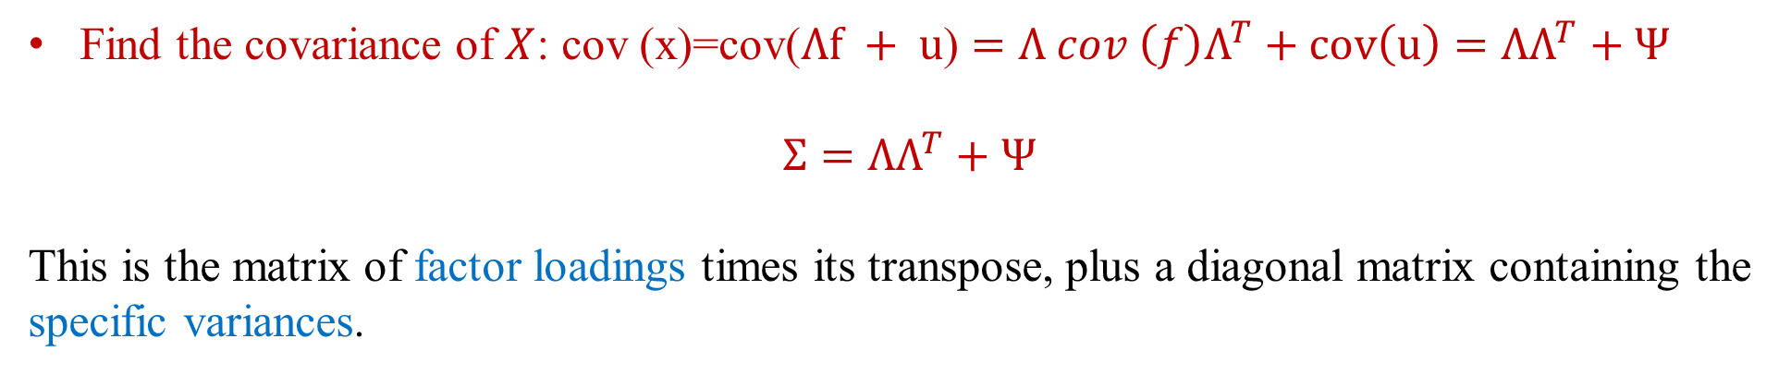
Factor Analysis Model
• manifest variables: $x_{1}, x_{2}, . . ., x_{q}$. latent variables or factors: $f_{1}, f_{2}, . . ., f_{k}$.
$x = Λf + u$, , $f= {\left(f_{1}, . . ., f_{k}\right)}^{T}, u = {\left(u_{1}, . . ., u_{q}\right)}^{T}$.
Find the covariance of $X$: cov (x)=cov($Λf + u$) $=Λ cov \left(f\right)Λ^{T}+cov\left(u\right)=ΛΛ^{T}+Ψ$
$$Σ=ΛΛ^{T}+Ψ$$
This is the matrix of factor loadings times its transpose, plus a diagonal matrix containing the specific variances.

Slide 8
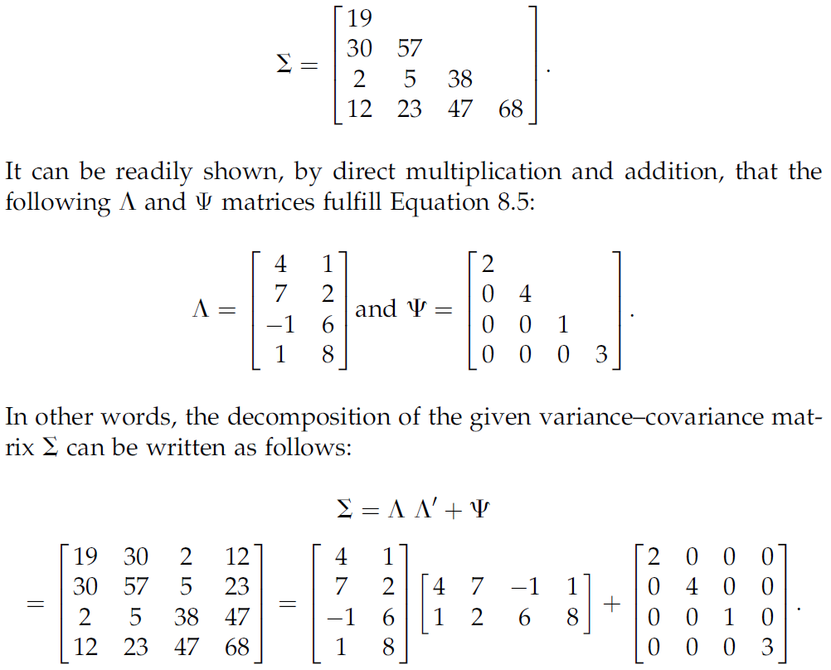

Slide 9
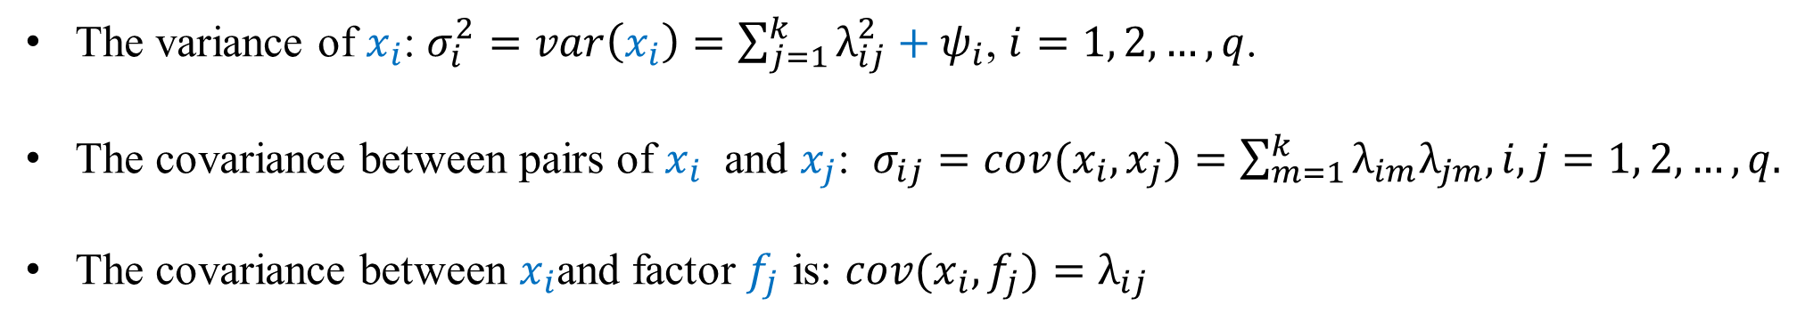
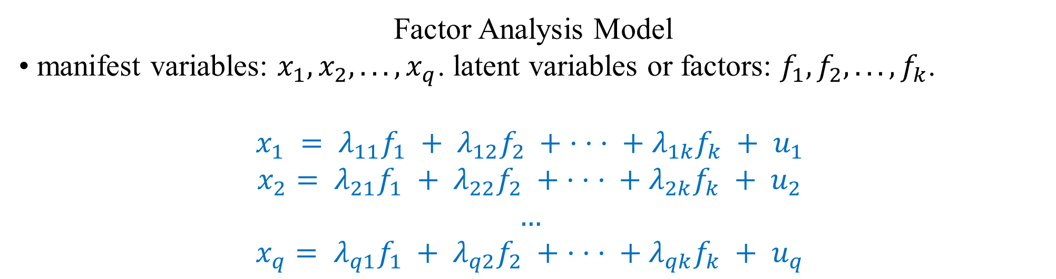
Factor Analysis Model
• manifest variables: $x_{1}, x_{2}, . . ., x_{q}$. latent variables or factors: $f_{1}, f_{2}, . . ., f_{k}$.
$$x_{1} = λ_{11}f_{1} + λ_{12}f_{2} + · · · + λ_{1k}f_{k} + u_{1}$$
$$x_{2}= λ_{21}f_{1} + λ_{22}f_{2} + · · · + λ_{2k}f_{k} + u_{2}$$
$$…$$
$$x_{q}= λ_{q1}f_{1} + λ_{q2}f_{2} + · · · + λ_{qk}f_{k} + u_{q}$$
The variance of $x_{i}$: $σ_{i}^{2}=var\left(x_{i}\right)=\sum_{j=1}^{k}{λ_{ij}^{2}}+ψ_{i}$, $i=1, 2, …, q$.
The covariance between pairs of $x_{i}$ and $x_{j}$: $σ_{ij}=cov(x_{i},x_{j})=\sum_{m=1}^{k}{λ_{im}λ_{jm}, i,j=1, 2, …,q.}$
The covariance between $x_{i}$and factor $f_{j}$ is: $cov(x_{i},f_{j})=λ_{ij}$

Slide 10
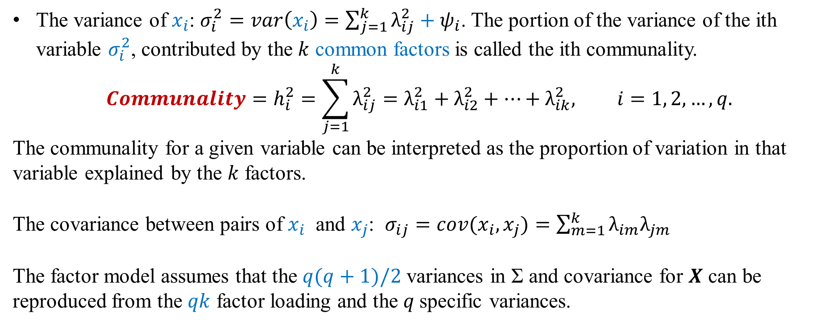
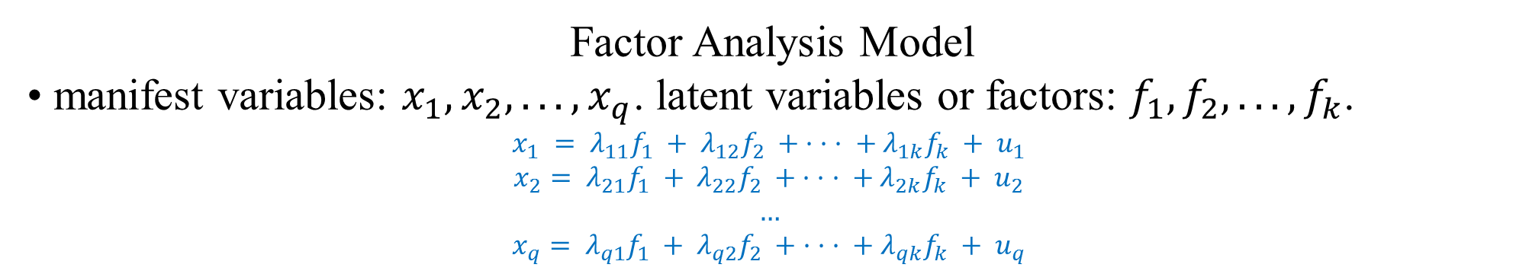
Factor Analysis Model
• manifest variables: $x_{1}, x_{2}, . . ., x_{q}$. latent variables or factors: $f_{1}, f_{2}, . . ., f_{k}$.
$$x_{1} = λ_{11}f_{1} + λ_{12}f_{2} + · · · + λ_{1k}f_{k} + u_{1}$$
$$x_{2}= λ_{21}f_{1} + λ_{22}f_{2} + · · · + λ_{2k}f_{k} + u_{2}$$
$$…$$
$$x_{q}= λ_{q1}f_{1} + λ_{q2}f_{2} + · · · + λ_{qk}f_{k} + u_{q}$$
The variance of $x_{i}$: $σ_{i}^{2}=var\left(x_{i}\right)=\sum_{j=1}^{k}{λ_{ij}^{2}}+ψ_{i}$. The portion of the variance of the ith variable $σ_{i}^{2}$, contributed by the $k$ common factors is called the ith communality.
$$Communality=h_{i}^{2}=\sum_{j=1}^{k}{λ_{ij}^{2}=λ_{i1}^{2}+λ_{i2}^{2}+…+λ_{ik}^{2}, i=1, 2, …, q.}$$
The communality for a given variable can be interpreted as the proportion of variation in that variable explained by the $k$ factors.
The covariance between pairs of $x_{i}$ and $x_{j}$: $σ_{ij}=cov(x_{i},x_{j})=\sum_{m=1}^{k}{λ_{im}λ_{jm}}$
The factor model assumes that the $q(q+1)/2$ variances in Σ and covariance for $X$ can be reproduced from the $qk$ factor loading and the $q$specific variances.

Slide 11
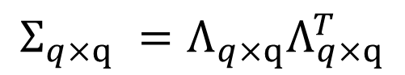
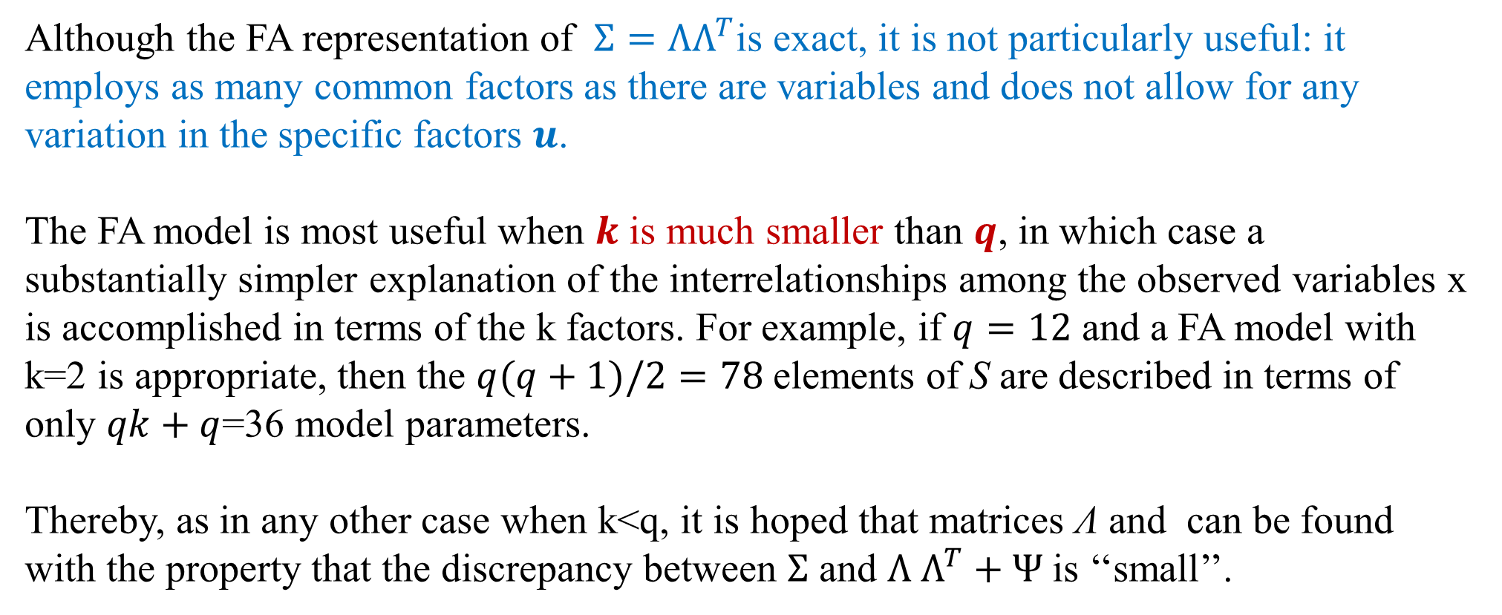
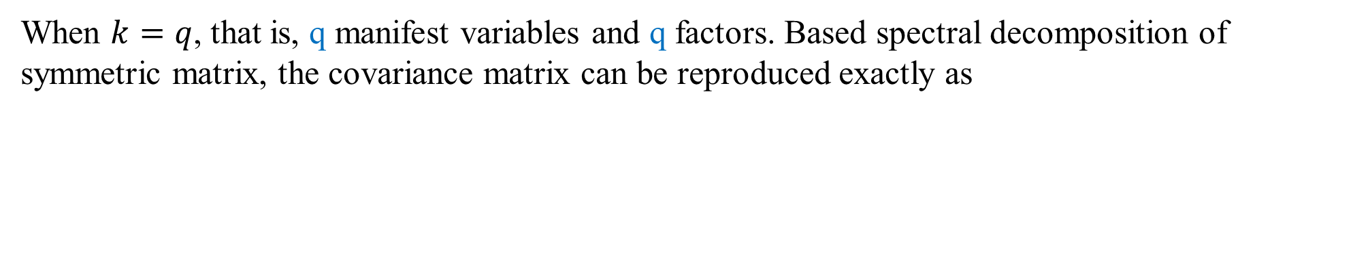
When $k=q$, that is, q manifest variables and q factors. Based spectral decomposition of symmetric matrix, the covariance matrix can be reproduced exactly as
$$Σ_{q×q} =Λ_{q×q}Λ_{q×q}^{T}$$
Although the FA representation of $Σ=ΛΛ^{T}$is exact, it is not particularly useful: it employs as many common factors as there are variables and does not allow for any variation in the specific factors $u$.
The FA model is most useful when $k$ is much smaller than $q$, in which case a substantially simpler explanation of the interrelationships among the observed variables x is accomplished in terms of the k factors. For example, if $q=12$ and a FA model with k=2 is appropriate, then the $q(q+1)/2=78$elements of S are described in terms of
only $qk+q$=36 model parameters.
Thereby, as in any other case when k<q, it is hoped that matrices Λ and can be found with the property that the discrepancy between $Σ$ and $Λ Λ^{T}+Ψ$is ‘‘small’’.

Slide 12
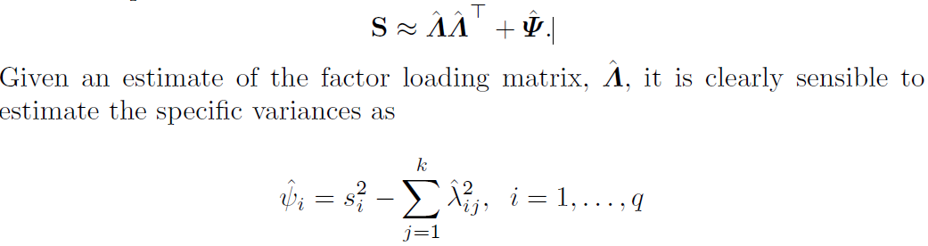
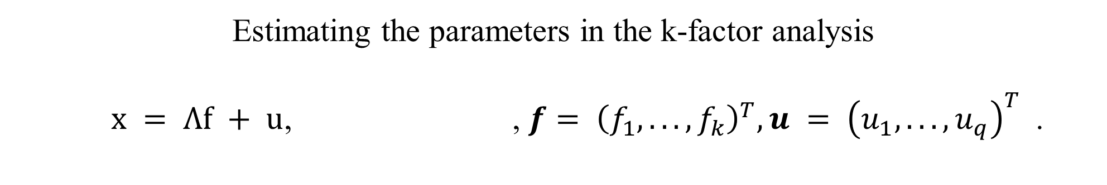
Estimating the parameters in the k-factor analysis
$x = Λf + u$, , $f= {\left(f_{1}, . . ., f_{k}\right)}^{T}, u = {\left(u_{1}, . . ., u_{q}\right)}^{T}$.
In matrix notation: $Σ=ΛΛ^{T}+Ψ$

Slide 13
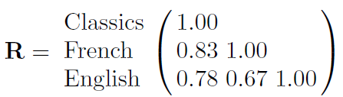
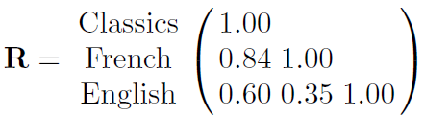
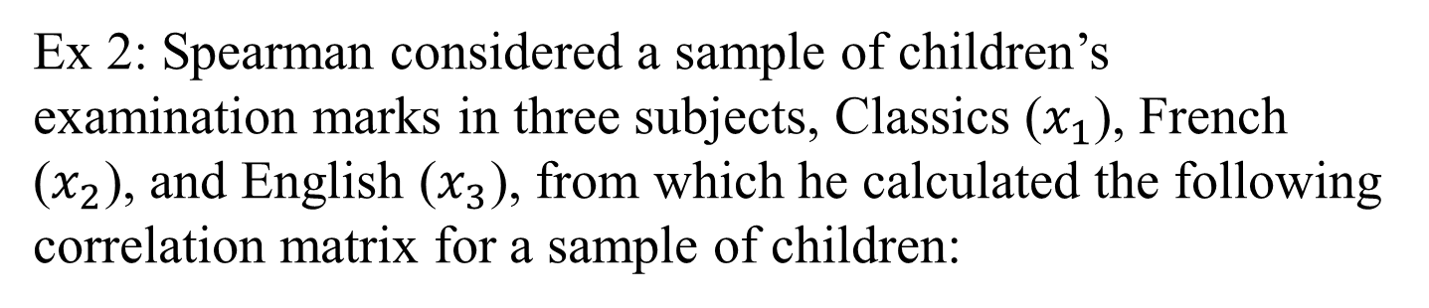
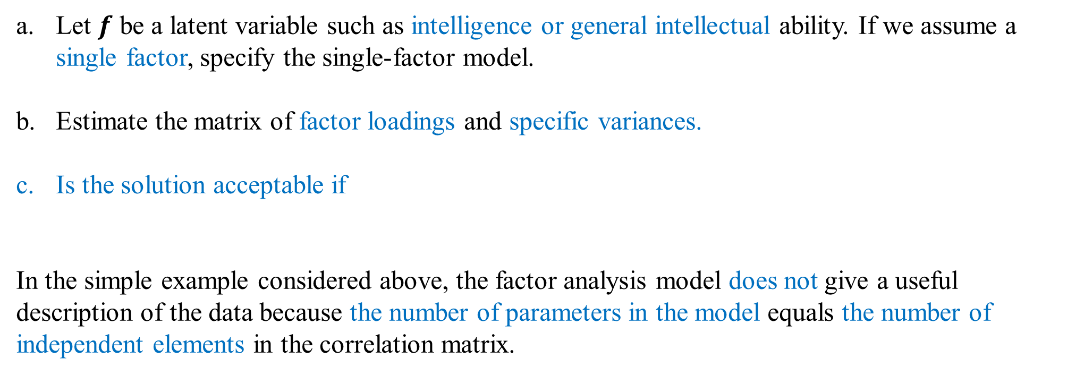
Ex 2: Spearman considered a sample of children’s examination marks in three subjects, Classics ($x_{1}$), French ($x_{2}$), and English ($x_{3}$), from which he calculated the following correlation matrix for a sample of children:
Let $f$ be a latent variable such as intelligence or general intellectual ability. If we assume a single factor, specify the single-factor model.
Estimate the matrix of factor loadings and specific variances.
Is the solution acceptable if
In the simple example considered above, the factor analysis model does not give a useful description of the data because the number of parameters in the model equals the number of independent elements in the correlation matrix.

Slide 14
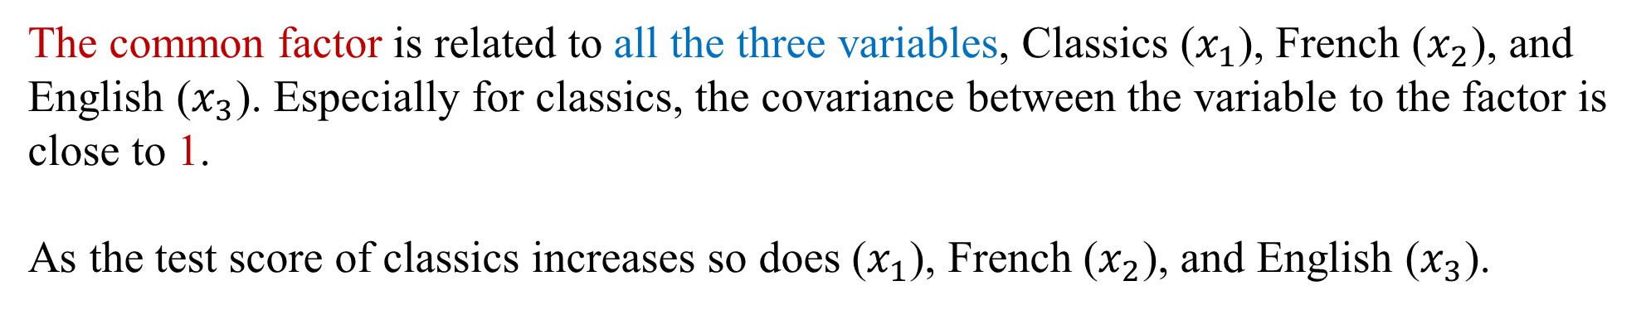
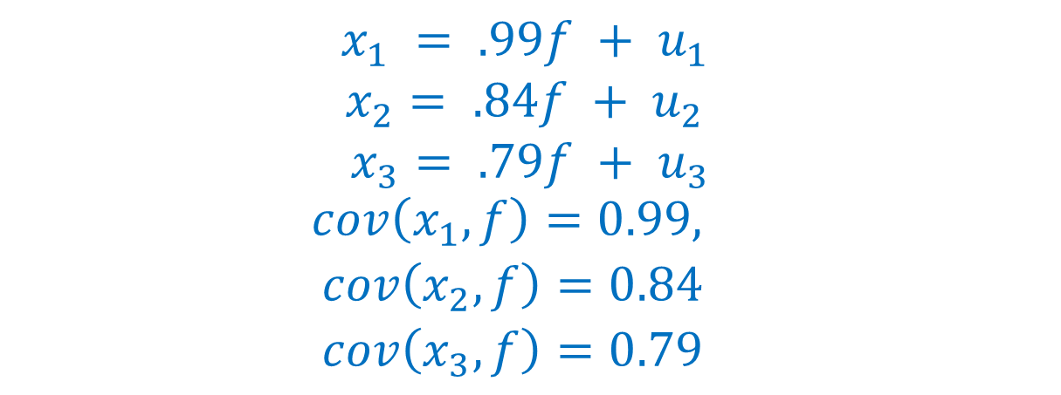
$$x_{1} = .99f + u_{1}$$
$$x_{2}= .84f + u_{2}$$
$$x_{3}= .79f + u_{3}$$
$${\begin{aligned}cov\left(x_{1},f\right)=0.99, \\ cov\left(x_{2},f\right)=0.84 \\ cov\left(x_{3},f\right)=0.79\end{aligned}}_{}$$
The common factor is related to all the three variables, Classics ($x_{1}$), French ($x_{2}$), and English ($x_{3}$). Especially for classics, the covariance between the variable to the factor is close to 1.
As the test score of classics increases so does ($x_{1}$), French ($x_{2}$), and English ($x_{3}$).

Slide 15
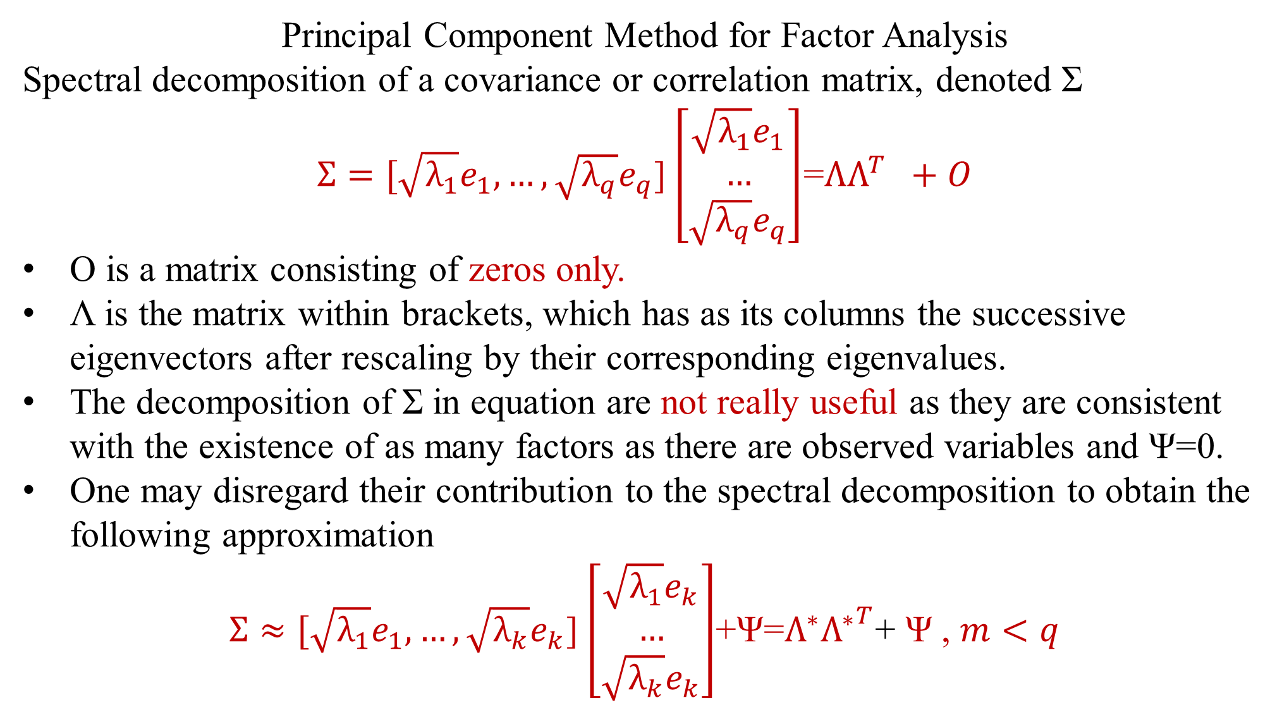
Principal Component Method for Factor Analysis
Spectral decomposition of a covariance or correlation matrix, denoted Σ
$Σ=[\sqrt{λ_{1}}e_{1}, …,\sqrt{λ_{q}}e_{q}$]$\left[\begin{matrix}\sqrt{λ_{1}}e_{1} \\ … \\ \sqrt{λ_{q}}e_{q}\end{matrix}\right]$=$ΛΛ^{T} +O$
O is a matrix consisting of zeros only.
Λ is the matrix within brackets, which has as its columns the successive eigenvectors after rescaling by their corresponding eigenvalues.
The decomposition of Σ in equation are not really useful as they are consistent with the existence of as many factors as there are observed variables and Ψ=0.
One may disregard their contribution to the spectral decomposition to obtain the following approximation
$Σ≈[\sqrt{λ_{1}}e_{1}, …,\sqrt{λ_{k}}e_{k}$]$\left[\begin{matrix}\sqrt{λ_{1}}e_{k} \\ … \\ \sqrt{λ_{k}}e_{k}\end{matrix}\right]$+Ψ=$Λ^{∗}{Λ^{∗}}^{T}$+ Ψ , $m<q$

Slide 16
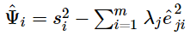
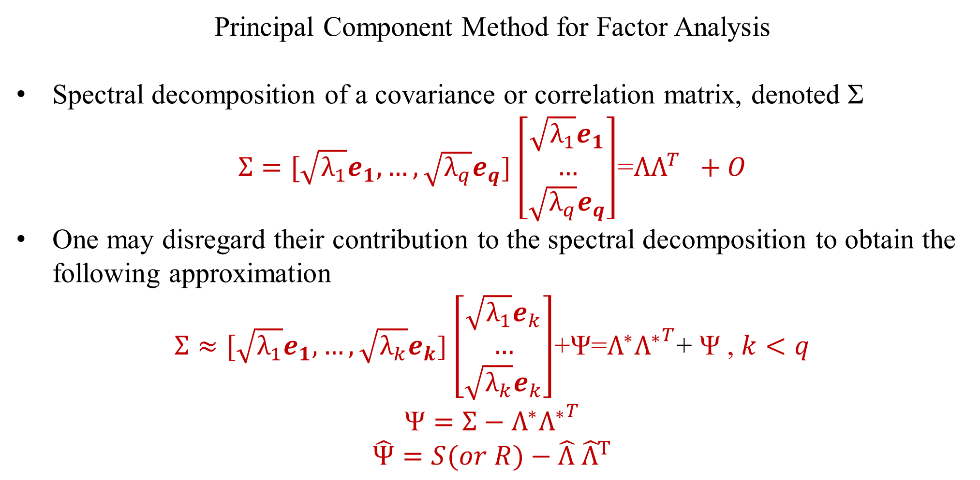
Principal Component Method for Factor Analysis
Spectral decomposition of a covariance or correlation matrix, denoted Σ
$Σ=[\sqrt{λ_{1}}e_{1}, …,\sqrt{λ_{q}}e_{q}$]$\left[\begin{matrix}\sqrt{λ_{1}}e_{1} \\ … \\ \sqrt{λ_{q}}e_{q}\end{matrix}\right]$=$ΛΛ^{T} +O$
One may disregard their contribution to the spectral decomposition to obtain the following approximation
$Σ≈[\sqrt{λ_{1}}e_{1}, …,\sqrt{λ_{k}}e_{k}$]$\left[\begin{matrix}\sqrt{λ_{1}}e_{k} \\ … \\ \sqrt{λ_{k}}e_{k}\end{matrix}\right]$+Ψ=$Λ^{∗}{Λ^{∗}}^{T}$+ Ψ , $k<q$
$$\text{Ψ}=Σ−Λ^{∗}{Λ^{∗}}^{T}$$
$\hat{Ψ}=S(or R)−\hat{Λ}$ ${\hat{Λ}}^{T}$

Slide 17
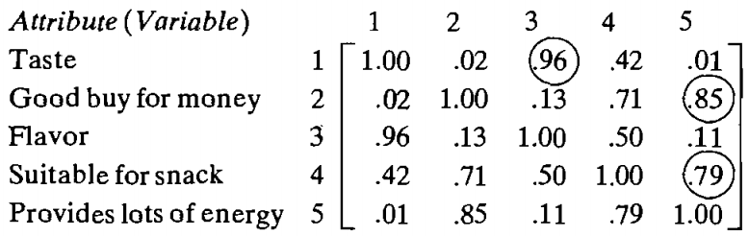
Example 4 In a consumer-preference study, a random sample of customers were asked to create several attributes of a new product. The response, on a 7 point semantic differential scale, were tabulated and the attribute correlation matrix constructed. The correlation matrix is presented next:
Perform a principal factor analysis on the data.

Slide 18
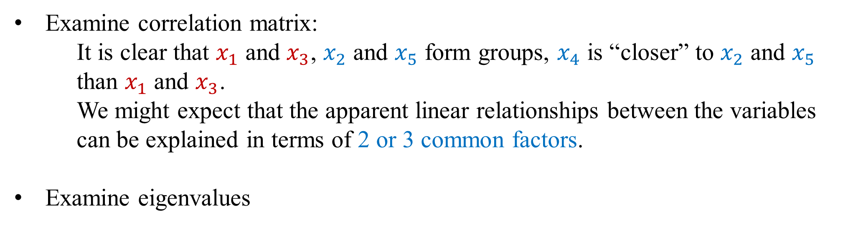
Question: How many common factor do we choose?
Examine correlation matrix:
It is clear that $x_{1}$ and $x_{3}$, $x_{2}$ and $x_{5}$ form groups, $x_{4}$ is “closer” to $x_{2}$ and $x_{5}$ than $x_{1}$ and $x_{3}$.
We might expect that the apparent linear relationships between the variables can be explained in terms of 2 or 3 common factors.
Examine eigenvalues

Slide 19
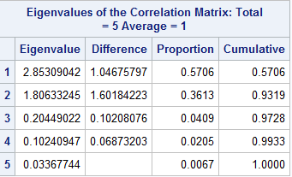
Determine k
> library("MVA")
> cov<-matrix(c(1, .02, .96, .42, .01, .02, 1, .13, .71, .85, .96, .13, 1, .5, .11, .42, .71, .5, 1, .79, .01, .85, .11, .79, 1), nrow=5, ncol=5, byrow=T)
> (e<-eigen(cov))
$values
[1] 2.85309042 1.80633245 0.20449022 0.10240947 0.03367744
$vectors
[,1] [,2] [,3] [,4] [,5]
[1,] 0.3314539 -0.60721643 0.09848524 0.1386643 0.701783012
[2,] 0.4601593 0.39003172 0.74256408 -0.2821170 0.071674637
[3,] 0.3820572 -0.55650828 0.16840896 0.1170037 -0.708716714
[4,] 0.5559769 0.07806457 -0.60158211 -0.5682357 0.001656352
[5,] 0.4725608 0.40418799 -0.22053713 0.7513990 0.009012569

Slide 20
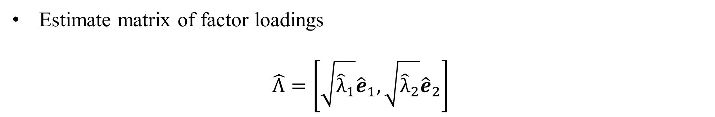
Determine k =2
> lam<-e$values
> sum<-cumsum(lam)
> (p<-sum/5)
[1] 0.5706181 0.9318846 0.9727826 0.9932645 1.0000000
Estimate matrix of factor loadings
$$\hat{Λ}=\left[\sqrt{{\hat{λ}}_{1}}{\hat{e}}_{1},\sqrt{{\hat{λ}}_{2}}{\hat{e}}_{2}\right]$$

Slide 21

Determine k =2
> lam<-e$values
> sum<-cumsum(lam)
> (p<-sum/5)
[1] 0.5706181 0.9318846 0.9727826 0.9932645 1.0000000
Estimate factor loadings$: \hat{Λ}=\left[\sqrt{{\hat{λ}}_{1}}{\hat{e}}_{1},\sqrt{{\hat{λ}}_{2}}{\hat{e}}_{2}\right]$
values<-as.matrix(e$values)
(f1<-sqrt(values[1,])*e$vectors[,1])
[1] 0.5598618 0.7772594 0.6453364 0.9391057 0.7982069
(f2<-sqrt(values[2,])*e$vectors[,2])
[1] -0.8160981 0.5242021 -0.7479464 0.1049187 0.5432281

Slide 22
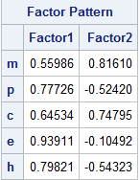

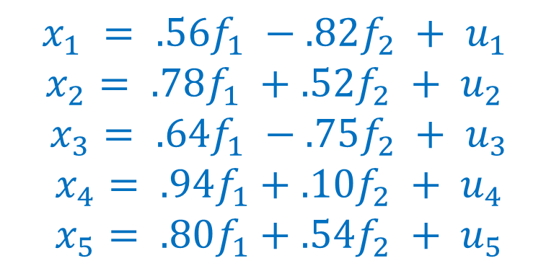
Determine k =2
Estimate factor loadings$\hat{Λ}=\left[\sqrt{{\hat{λ}}_{1}}{\hat{e}}_{1},\sqrt{{\hat{λ}}_{2}}{\hat{e}}_{2}\right]$
(cf1<-sqrt(values[1,])*e$vectors[,1])
[1] 0.5598618 0.7772594 0.6453364 0.9391057 0.7982069
(cf2<-sqrt(values[2,])*e$vectors[,2])
[1] -0.8160981 0.5242021 -0.7479464 0.1049187 0.5432281
$$x_{1} = .56f_{1} −.82f_{2} + u_{1}$$
$$x_{2}= .78f_{1} +.52f_{2} + u_{2}$$
$$x_{3}= .64f_{1} −.75f_{2} + u_{3}$$
$$x_{4}= .94f_{1}+.10f_{2} + u_{4}$$
$$x_{5}= .80f_{1}+.54f_{2} + u_{5}$$

Slide 23
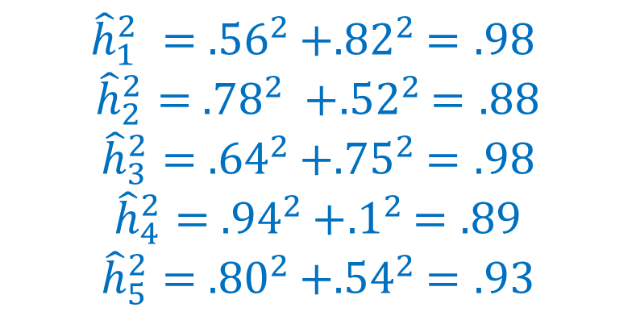
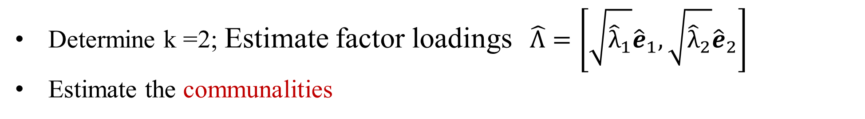
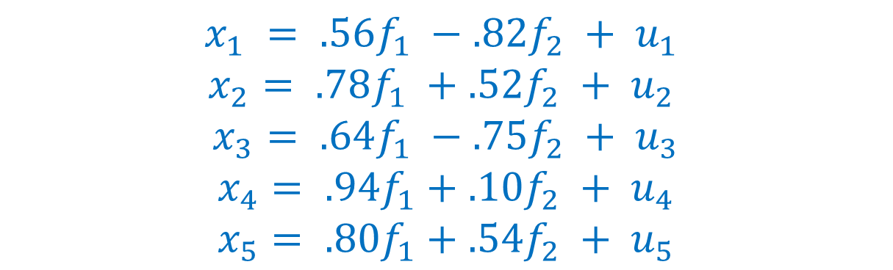
Determine k =2; Estimate factor loadings$\hat{Λ}=\left[\sqrt{{\hat{λ}}_{1}}{\hat{e}}_{1},\sqrt{{\hat{λ}}_{2}}{\hat{e}}_{2}\right]$
Estimate the communalities
$$x_{1} = .56f_{1} −.82f_{2} + u_{1}$$
$$x_{2}= .78f_{1} +.52f_{2} + u_{2}$$
$$x_{3}= .64f_{1} −.75f_{2} + u_{3}$$
$$x_{4}= .94f_{1}+.1{0f}_{2} + u_{4}$$
$$x_{5}= .80f_{1}+.54f_{2} + u_{5}$$
$${\hat{h}}_{1}^{2} = {.56}^{2}+{.82}^{2}=.98$$
$${\hat{h}}_{2}^{2}= {.78}^{2} +{.52}^{2}=.88$$
$${\hat{h}}_{3}^{2}= {.64}^{2}+{.75}^{2}=.98$$
$${\hat{h}}_{4}^{2}= {.94}^{2}+{.1}^{2}=.89$$
$${\hat{h}}_{5}^{2}= {.80}^{2}+{.54}^{2}=.93$$
h2<-cf1^2+cf2^2
[1] 0.9794614 0.8789200 0.9758829 0.8929275 0.9322311
E$stimate \hat{Ψ}={\hat{s}}_{i}^{2}−{\hat{h}}_{i}^{2}$=$1−{\hat{h}}_{i}^{2}$
phi<-1-h
[1] 0.02053865 0.12107998 0.02411712 0.10707250 0.06776888

Slide 24

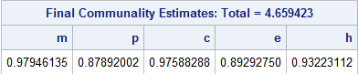
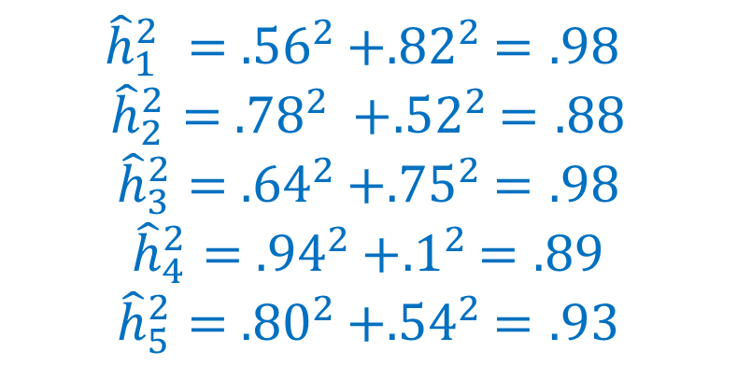
Determine k =2; Estimate factor loadings$\hat{Λ}=\left[\sqrt{{\hat{λ}}_{1}}{\hat{e}}_{1},\sqrt{{\hat{λ}}_{2}}{\hat{e}}_{2}\right]$
Estimate the communalities
$${\hat{h}}_{1}^{2} = {.56}^{2}+{.82}^{2}=.98$$
$${\hat{h}}_{2}^{2}= {.78}^{2} +{.52}^{2}=.88$$
$${\hat{h}}_{3}^{2}= {.64}^{2}+{.75}^{2}=.98$$
$${\hat{h}}_{4}^{2}= {.94}^{2}+{.1}^{2}=.89$$
$${\hat{h}}_{5}^{2}= {.80}^{2}+{.54}^{2}=.93$$
h2<-cf1^2+cf2^2
[1] 0.9794614 0.8789200 0.9758829 0.8929275 0.9322311
E$stimate \hat{Ψ}={\hat{s}}_{i}^{2}−{\hat{h}}_{i}^{2}$=$1−{\hat{h}}_{i}^{2}$
phi<-1-h
[1] 0.02053865 0.12107998 0.02411712 0.10707250 0.06776888

Slide 25
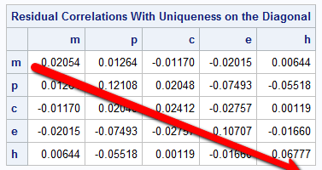
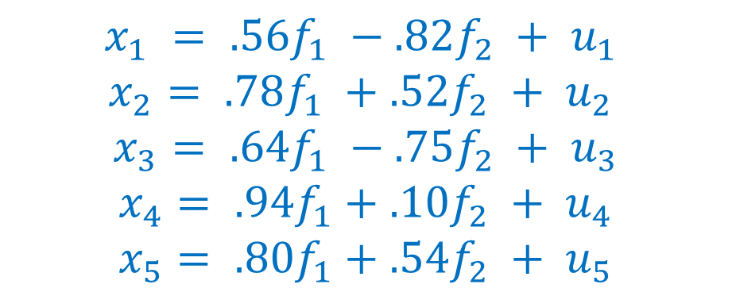
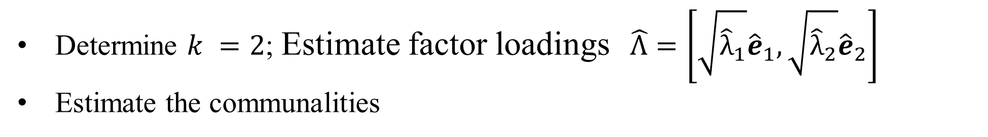
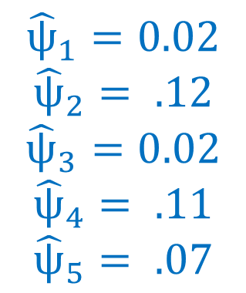
Determine $k =2$; Estimate factor loadings$\hat{Λ}=\left[\sqrt{{\hat{λ}}_{1}}{\hat{e}}_{1},\sqrt{{\hat{λ}}_{2}}{\hat{e}}_{2}\right]$
Estimate the communalities
h2<-cf1^2+cf2^2
[1] 0.9794614 0.8789200 0.9758829 0.8929275 0.9322311
E$stimate \hat{Ψ}={\hat{s}}_{i}^{2}−{\hat{h}}_{i}^{2}$=$1−{\hat{h}}_{i}^{2}$
phi<-1-h2
[1] 0.02053865 0.12107998 0.02411712 0.10707250 0.06776888
$$x_{1} = .56f_{1} −.82f_{2} + u_{1}$$
$$x_{2}= .78f_{1} +.52f_{2} + u_{2}$$
$$x_{3}= .64f_{1} −.75f_{2} + u_{3}$$
$$x_{4}= .94f_{1}+.1{0f}_{2} + u_{4}$$
$$x_{5}= .80f_{1}+.54f_{2} + u_{5}$$
$${\hat{ѱ}}_{1}=0.02$$
$${\hat{ѱ}}_{2}= .12$$
$${\hat{ѱ}}_{3}=0.02$$
$${\hat{ѱ}}_{4}= .11$$
$${\hat{ѱ}}_{5}= .07$$

Slide 26
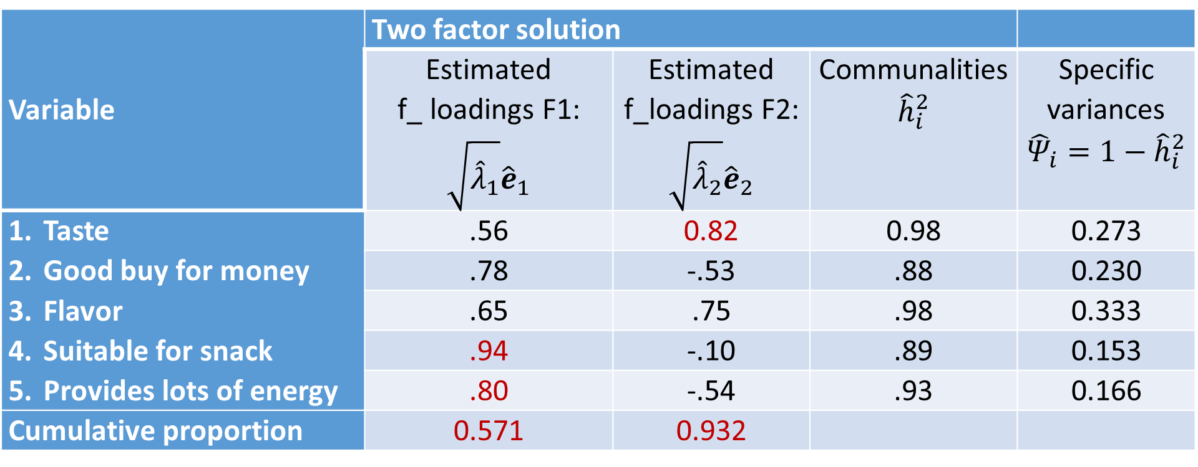
Variable | Two factor solution
 | Estimated f_ loadings F1: $\sqrt{{\hat{λ}}_{1}}{\hat{e}}_{1}$ | Estimated f_loadings F2: $\sqrt{{\hat{λ}}_{2}}{\hat{e}}_{2}$ | Communalities $${\hat{h}}_{i}^{2}$$ | Specific variances $${{\hat{Ψ}}_{i}=1−\hat{h}}_{i}^{2}$$
Taste Good buy for money Flavor Suitable for snack Provides lots of energy | .56 | 0.82 | 0.98 | 0.273
 | .78 | -.53 | .88 | 0.230
 | .65 | .75 | .98 | 0.333
 | .94 | -.10 | .89 | 0.153
 | .80 | -.54 | .93 | 0.166
Cumulative proportion | 0.571 | 0.932

Slide 27
data corrmatr (type=corr);
input m p c e h;
type='corr';
cards;
1 0.02 .96 .42 .01
.02 1 .13 .71 .85
.96 .13 1 .5 .11
.42 .71 .5 1 .79
.01 .85 .11 .79 1
;
run;
proc print data=corrmatr;
run;
proc factor method=PRINCIPAL corr msa residuals;
var m p c e h;
run;

Slide 28
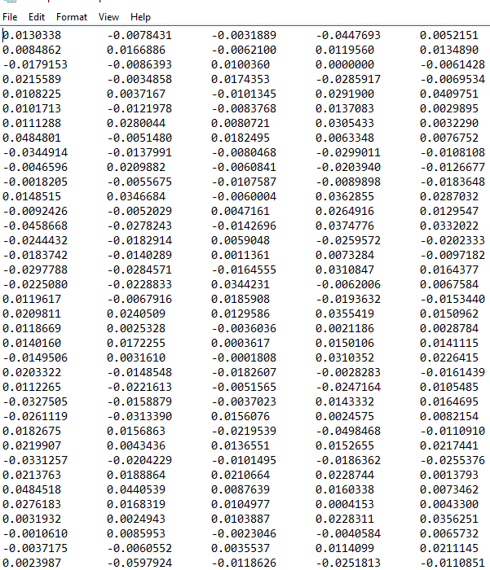

Example 4 The weekly rates of return for five stocks (JP Morgan, Citibank, Wells Fargo, Royal Dutch Shell, and ExxonMobil) listed on the New York Stock Exchange were determined for the period January 2004 through December 2005. The weekly rates of return are defined as (current week closing price-previous week closing prices)/ previous week closing price), adjusted for stock splits and dividends. The observations in 103 successive weeks appear to be independently distributed, but the rates of return across stocks are correlated, because as one expects, stocks tend to move together in response to general economic conditions.
Stock-price data consisting of $n=103$ weekly rates of return on $q=5$. Let $x_{1}, x_{2}, …, x_{5}$denote observed weekly rates of return for JP Morgan Citibank, wells Fargo, Royal Dutch Shell, and ExxonMobil.
Perform a principal analysis on the data. ${Are x}_{1},x_{2},…, x_{5}$ related to some factors?

Slide 29

Stock-price data consisting of $n=103$ weekly rates of return on $q=5$. Let $x_{1}, x_{2}, …, x_{5}$denote observed weekly rates of return for JP Morgan Citibank, wells Fargo, Royal Dutch Shell, and ExxonMobil.
Perform a principal analysis on the data.
${Are x}_{1},x_{2},…, x_{5}$ related to some factors?

Slide 30


Slide 31
(e<-eigen(cor)) $values [1] 2.4372731 1.4070127 0.5005127 0.4000316 0.2551699 $vectors [,1] [,2] [,3] [,4] [,5] [1,] -0.4690832 0.3680070 -0.60431522 0.3630228 0.38412160 [2,] -0.5324055 0.2364624 -0.13610618 -0.6292079 -0.49618794 [3,] -0.4651633 0.3151795 0.77182810 0.2889658 0.07116948 [4,] -0.3873459 -0.5850373 0.09336192 -0.3812515 0.59466408 [5,] -0.3606821 -0.6058463 -0.10882629 0.4934145 -0.49755167 lam<-e$values sum<-cumsum(lam) (p<-sum/5) [1] 0.4874546 0.7688572 0.8689597 0.9489660 1.0000000

Slide 32
values<-as.matrix(e$values) (Cf1<-sqrt(values[1,])*e$vectors[,1]) [1] -0.7323218 -0.8311791 -0.7262022 -0.6047155 -0.5630885 (Cf2<-sqrt(values[2,])*e$vectors[,2]) [1] 0.4365209 0.2804859 0.3738582 -0.6939569 -0.7186401 h2<-Cf1^2+Cf2^2 phi<-1-h2 [1] 0.2731542 0.2304689 0.3328604 0.1527429 0.1664878 > (Cf3<-sqrt(values[3,])*e$vectors[,3]) [1] -0.42753444 -0.09629094 0.54604465 0.06605069 -0.07699125 h2<-Cf1^2+Cf2^2+Cf3^2 phi<-1-h2 [1] 0.09036854 0.22119699 0.03469560 0.14838022 0.16056011

Slide 33

Variable | Two factor solution |  |  | Three-factor solution
 | Estimated f_ loadings F1: $\sqrt{{\hat{λ}}_{1}}{\hat{e}}_{1}$ | Estimated f_loadings F2:$\sqrt{{\hat{λ}}_{2}}{\hat{e}}_{2}$ | Specific variances $${{\hat{Ψ}}_{i}=1−\hat{h}}_{i}^{2}$$ | Estimated f_loadings F1: $$\sqrt{{\hat{λ}}_{1}}{\hat{e}}_{1}$$ | Estimated f_loadings F2:$\sqrt{{\hat{λ}}_{2}}{\hat{e}}_{2}$ | Estimated f_loadings F3: $$\sqrt{{\hat{λ}}_{3}}{\hat{e}}_{3}$$ | Specific variances $${{\hat{Ψ}}_{i}=1−\hat{h}}_{i}^{2}$$
JP Morgan Citibank Wells Fargo Royal Dutch Shell ExxonMobil | .731 | -.437 | 0.273 | .731 | -.437 | 0.43 | 0.09
 | .831 | -.28 | 0.230 | .831 | -.28 | .096 | 0.22
 | .726 | -.374 | 0.333 | .726 | -.374 | -.546 | 0.035
 | .605 | .694 | 0.153 | .605 | .694 | -.066 | 0.15
 | .563 | .719 | 0.166 | .563 | .719 | .076 | 0.16
Cumulative proportion | 0.487 | .769 |  | 0.487 | .769 | 0.869

Slide 34



Variable | Two factor solution |  |  | Three-factor solution
 | Estimated f_ loadings F1: $\sqrt{{\hat{λ}}_{1}}{\hat{e}}_{1}$ | Estimated f_loadings F2:$\sqrt{{\hat{λ}}_{2}}{\hat{e}}_{2}$ | Specific variances $${{\hat{Ψ}}_{i}=1−\hat{h}}_{i}^{2}$$ | Estimated f_loadings F1: $$\sqrt{{\hat{λ}}_{1}}{\hat{e}}_{1}$$ | Estimated f_loadings F2:$\sqrt{{\hat{λ}}_{2}}{\hat{e}}_{2}$ | Estimated f_loadings F3: $$\sqrt{{\hat{λ}}_{3}}{\hat{e}}_{3}$$ | Specific variances $${{\hat{Ψ}}_{i}=1−\hat{h}}_{i}^{2}$$
JP Morgan Citibank Wells Fargo Royal Dutch Shell ExxonMobil | .731 | -.437 | 0.273 | .731 | -.437 | 0.43 | 0.09
 | .831 | -.28 | 0.230 | .831 | -.28 | .096 | 0.22
 | .726 | -.374 | 0.333 | .726 | -.374 | -.546 | 0.035
 | .605 | .694 | 0.153 | .605 | .694 | -.066 | 0.15
 | .563 | .719 | 0.166 | .563 | .719 | .076 | 0.16
Cumulative proportion | 0.487 | .769 |  | 0.487 | .769 | 0.869
$$\left[\begin{matrix}\begin{matrix}0 & −.099 \\ −.099 & 0 \\ −.185 & −.134\end{matrix} & \begin{matrix}−.185 & −.025 & .056 \\ −.134 & .014 & −.054 \\ 0 & .003 & .006\end{matrix} \\ \begin{matrix}−.025 & .014 \\ .056 & −.054\end{matrix} & \begin{matrix}.003 & 0 & −.156 \\ .006 & −.156 & 0\end{matrix}\end{matrix}\right]$$
The residual matrix =$R−\hat{Λ}$ ${\hat{Λ}}^{T}−\hat{ѱ}=$

Slide 35


Variable | Two factor solution
 | f_ loadings F1: $\sqrt{{\hat{λ}}_{1}}{\hat{e}}_{1}$ | f_loadings F2:$\sqrt{{\hat{λ}}_{2}}{\hat{e}}_{2}$ | Specific variances $${{\hat{Ψ}}_{i}=1−\hat{h}}_{i}^{2}$$
JP Morgan Citibank Wells Fargo Royal Dutch Shell ExxonMobil | .731 | -.437 | 0.273
 | .831 | -.28 | 0.230
 | .726 | -.374 | 0.333
 | .605 | .694 | 0.153
 | .563 | .719 | 0.166
Cumulative proportion | 0.487 | .769
$Cov\left(JP, f_{1}\right)=0.731, cov\left(CB, f_{1}\right)=0.831, and cov\left(WF, f_{1}\right)=0.726$.
Factor 1 represents general economic conditions and might be called a market factor. All of the stocks load highly on this factor, and the loadings are about equal.

Slide 36


Variable | Two factor solution
 | f_ loadings F1: $\sqrt{{\hat{λ}}_{1}}{\hat{e}}_{1}$ | f_loadings F2:$\sqrt{{\hat{λ}}_{2}}{\hat{e}}_{2}$ | Specific variances $${{\hat{Ψ}}_{i}=1−\hat{h}}_{i}^{2}$$
JP Morgan Citibank Wells Fargo Royal Dutch Shell ExxonMobil | .731 | -.437 | 0.273
 | .831 | -.28 | 0.230
 | .726 | -.374 | 0.333
 | .605 | .694 | 0.153
 | .563 | .719 | 0.166
Cumulative proportion | 0.487 | .769
$Cov\left(RDS, f_{2}\right)=0.694, cov\left(EM, f_{2}\right)=0.719$.
Factor 2 contrasts the banking stocks with the oil stocks. The banks having relatively large negative loadings, and the oils have large positive loadings, on the factor. Thus, Factor 2 seems to differentiate stocks in different industries and might be called an industry factor.

Slide 37




Variable | Two factor solution
 | f_ loadings F1: $\sqrt{{\hat{λ}}_{1}}{\hat{e}}_{1}$ | f_loadings F2:$\sqrt{{\hat{λ}}_{2}}{\hat{e}}_{2}$ | Specific variances $${{\hat{Ψ}}_{i}=1−\hat{h}}_{i}^{2}$$
JP Morgan Citibank Wells Fargo Royal Dutch Shell ExxonMobil | .731 | -.437 | 0.273
 | .831 | -.28 | 0.230
 | .726 | -.374 | 0.333
 | .605 | .694 | 0.153
 | .563 | .719 | 0.166
Cumulative proportion | 0.487 | .769
The residual matrix =$R−\hat{Λ}$ ${\hat{Λ}}^{T}−\hat{ѱ}$
$$\left[\begin{matrix}\begin{matrix}0 & −.099 \\ −.099 & 0 \\ −.185 & −.134\end{matrix} & \begin{matrix}−.185 & −.025 & .056 \\ −.134 & .014 & −.054 \\ 0 & .003 & .006\end{matrix} \\ \begin{matrix}−.025 & .014 \\ .056 & −.054\end{matrix} & \begin{matrix}.003 & 0 & −.156 \\ .006 & −.156 & 0\end{matrix}\end{matrix}\right]$$
To summarize, rates of return appear to be determined by general market (factor 1) conditions and activities (factor 2) that are unique to the different industries, as well as a residual ($R−\hat{Λ}$ ${\hat{Λ}}^{T}−\hat{ѱ}$ ) or firm specific factor (${\hat{Ψ}}_{i}>0.15$).

Slide 38

cor<-cor(stock)
(e<-eigen(cor))
lam<-e$values
sum<-cumsum(lam)
(p<-sum/5)
vectors<-as.matrix(e$vectors)
a<-diag(sqrt(e$values))
lambda<-vectors%*%a #factor loading
phi<-1-rowSums((lambda[,1:2])^2)
residual<-cor-lambda[,1:2]%*%t(lambda[,1:2])-diag(phi)
residual<-round(residual,3)

Slide 39

Non-uniqueness of factor loadings
Suppose that the $k$-factor model holds for $x=Λf+u$, then $Σ$= $ΛΛ^{T}$+ Ψ .
Let $M$ be a $k×k$ orthonormal matrix.
$x = ΛMM^{T}f + u ⇒ x = Λ^{∗}f^{∗} + u,$where $Λ^{∗} = ΛM$and$f^{∗} = M^{T}f$.
Compute the covariance of x
$$Σ = Λ^{∗}{{cov (f^{∗})Λ}^{∗}}^{T} + Ψ$$
$$Σ = ΛM{{(M}^{T}M)\left(ΛM\right)}^{T} + Ψ$$
$$Σ = ΛM{IM}^{T}Λ^{T} + Ψ$$
$$Σ = ΛΛ^{T} + Ψ$$
Factors $f$ with loadings $Λ$, or factors $M^{T}f$ with loadings $ΛM$ are equivalent for explaining the covariance matrix of the observed variables, how can we deal with this?

Slide 40

Ways of Solving the Nonuniqueness Problem
• Force $Λ^{T}ѱ^{−1}Λ$ to be a diagonal matrix with its diagonal elements in descending order.
• This constraint resembles the PCA constraint that orders the importance of the principal components. The first factor will contribute the most to the shared variance of the manifest variables. The second factor is the factor that contributed the second-most to this shared variance, among all possible factors that are uncorrelated with the first factor, and so on.
• Such a choice of constraint can lead to factors with poor interpretation (having substantial loadings on many variables, or having both positive and negative loadings).

Slide 41

What is a More Interpretable Solution?
• Since there are infinite solutions $M^{T}f$ for $x=Λf+u with Σ$= $ΛΛ^{T}$+ Ψ, what kind of solution is easily “interpretable”?
• We would like each factor to have high loadings on only a few variables, and other loadings to be near zero. Each factor is substantially based on only a couple of variables.
• We would like each variable to have a high loading for only one factor. And variables don’t contribute to multiple factors.
 | F1 | F2 | F3
V1 | #
V2 |  | #
V3 | #
V4 | # |  | #
V5 |  | #

Slide 42


What is the technique to make a matrix into such matrix in above?
What is the technique to simplify $ax^{2}+bxy+cy^{2}+dx+cy+d=0?$

Slide 43

Methods of Factor Rotation
• Find an alternative factor solution simply by choosing some orthogonal matrix $M$ and using the loadings $Λ^{∗} = ΛM$.
Choosing a matrix $M$ to rotating the variables’ axes so that the factor loadings (when plotted) fall closer to those axes.
• There are two classes of rotation: orthogonal and oblique.
• Orthogonal rotations preserve the property that the factors are uncorrelated with each other, $M^{T}f$ orthogonal, making interpretation easier.
• Oblique rotations allow for factors to be correlated with each other, $M^{T}f$ orthogonal are not orthogonal.

Slide 44

Is Factor Rotation Valid?
• Some have argued that factor rotation is too subjective, allowing the investigator to produce whatever conclusion he/she wants.
• The essential solution does not change, however. The reason for rotation is simply to provide a more understandable interpretation of the solution.
• The initial constraint that $Λ^{T}Ψ^{−1}Λ$be diagonal is useful computationally, but can produce a solution that is not very interpretable.
• Rotation is particularly useful for maximum likelihood factor analysis.

Slide 45

Math behind Factor Analysis
Given $R(q ×q),$ﬁnd $\hat{Ψ}$ (q × q) and $\hat{Λ}$(q× k) that satisfy constraint , so that$R$−$\hat{Ψ}≈{\hat{ Λ}\hat{Λ}}^{T}$. Look at R$− \hat{Ψ}$, we only are interested in explaining the (co)variances that are shared through the common factors.
R$− \hat{Ψ}$ is symmetric. R$− \hat{Ψ}$= $VAV^{T}$, where A =diag($a_{1}, a_{2}, …, a_{q}$). Contains the eigenvalues of R$− \hat{Ψ},a_{1}≥ a_{2}≥…≥a_{q}$. V contains the corresponding orthonormal eigenvectors.
If the ﬁrst $k$ eigenvalues are positive, and the remaining ones are close to zero, then R$− \hat{Ψ}$≈ $V_{1}A_{1}V_{1}^{T}≈V_{1}{A_{1}}^{1/2}{{(V}_{1}{A_{1}}^{1/2})}^{T}$, $\hat{Λ}{=V}_{1}{A_{1}}^{1/2}$

Slide 46

Procedure
Estimate correlation matrix by $R_{q×q}$. Obtain preliminary estimates ${\hat{h}}_{i}^{2}$ of the communalities $h_{i}^{2}$, using (Text Page 141)
1) The square of the multiple correlation coefficient of the ith variable with all the other variables or
2) The largest correlation coefficient between the ith variable and one of the other variables.
Since 1$− \hat{Ψ_{i}^{2}}$=${\hat{h}}_{i}^{2}$, one can obtain an initial value for R$− \hat{Ψ}$ by ${\hat{h}}_{i}^{2}$, i=1, 2, …, q. yielding $R−\hat{ѱ}$.
Determine the spectral decomposition of $R−\hat{ѱ}$
Fix $k$ and determine $V_{1}$ and $A_{1}$. Estimate $\hat{Λ}$ by $\hat{Λ}{=V}_{1}{A_{1}}^{1/2}$.
Update ${\hat{h}}_{i}^{2}$=$\sum_{j=1}^{k}{λ_{ij}^{2}=λ_{i1}^{2}+λ_{i2}^{2}+…+λ_{ik}^{2}, i=1, 2, …, q.}$
Repeat the above steps until some convergence criterion has been reached.
Output $\hat{Λ}$ , ${\hat{h}}_{i}^{2}$ and ${\hat{ѱ}}_{i}^{2}=1−{\hat{h}}_{i}^{2}$, $i=1, 2, …, q.$

Slide 47

Estimating the parameters in the k-factor analysis
$Σ$ is usually estimated by $S$ (or often: correlation matrix is estimated by $R$) . Given $S$ (or $R$), we need to ﬁnd estimates $\hat{Λ}$and $\hat{Ψ}$ that satisfy constraint 1 or 2, so that $S$ (or $R$) $≈{\hat{Λ}\hat{Λ}}^{T}+\hat{Ψ}$
The number of parameters in $\hat{Λ}$ and $\hat{Ψ}$is smaller than the number of parameters in $S$. Hence, there is no exact solution in general.
Two main methods to estimate $\hat{Λ}$and $\hat{Ψ}$:
Principal factor analysis
Maximum likelihood estimation (requires normality assumption)

Slide 48


Maximum Likelihood Factor Analysis
• Classical ML requires an assumption about the form of the distribution of the data are multivariate normal. It can motivate a ML estimation of $k$-factor model.
• The observed sample covariance matrix is $S$ and, under the factor analysis model,
$Σ = ΛΛ^{T} + Ψ$. The goodness-of-fit of the $k$-factor model can be judged by a “distance” measure $F$ between the sample covariance matrix and the predicted covariance matrix under the model.

Slide 49

Maximum Likelihood Estimation
• Assume that$X$ has a multivariate normal distribution
• Then log likelihood function
$l\left(Σ\right)=−\frac{1}{2}log\left|2π\left(ΛΛ^{T}\text{+ }\text{Ψ}\right)\right|−\frac{1}{2}n trace({\left(ΛΛ^{T}\text{+ }\text{Ψ}\right)}^{−1}S)$.
• Regard $Σ$= $ΛΛ^{T}$+ Ψ as a function of $Λ and$Ψ, and maximize the log likelihood function over $Λ and$Ψ
Optimization is done iteratively:
For fixed $Ψ$, one can maximize analytically over $Λ$
For fixed $Λ$, one can maximize numerically over $Ψ$
This method is used by the R-function factanal()

Slide 50

Estimating the Number of Factors
• Unlike a principal components analysis, in ML factor analysis, the choice of the number of factors $k$ is critical. If we use $k + 1$factors, we will get different factors and loadings than if we use $k$ factors.
• With too few factors, there will be too many high loadings.
• With too many factors, the loadings will be spread out too much over the factors, and the factors will be difficult to interpret.

Slide 51

Testing for number of factor
Advantage of the MLE method is that it allows to test if the number of factors, $k$, is sufficient:
$H_{0}$: $k$ factors is sufficient to describe the data$v.s.$
$H_{a}$: $k$ factors is not sufficient
P-value$<0.05$ means reject null hypothesis.
We could use the scree diagram as in PCA, but the eigenvalues are not as directly interpretable in factor analysis.

Slide 52

Methods for Estimating the Number of Factors
• When using maximum likelihood, we can use a formal sequence of hypothesis tests to help determine $k$.
• The test statistic $U =Nmin⁡(F),$where $N= n+1−(2q+5)/6−2k/3$.
• If the $k$-factor model is appropriate, this test statistic has a large-sample $χ^{2}$ distribution with degrees of freedom ${\left(q − k\right)}^{2}/2 − (q + k)/2$.
• Typically we begin with a small value of $k$, and increase $k$ by 1 sequentially.
• If at any stage, the U has a non-significant P-value, we choose that value of $k$.
• If at any stage the degrees of freedom go to zero, the factor analysis model may be inappropriate.

Slide 53

Ex 4 The weekly rates of return for five stocks (JP Morgan, Citibank, Wells Fargo, Royal Dutch Shell, and ExxonMobil) listed on the New York Stock Exchange were determined for the period January 2004 through December 2005. The weekly rates of return are defined as (current week closing price-previous week closing prices)/ previous week closing price), adjusted for stock splits and dividends. The observations in 103 successive weeks appear to be independently distributed, but the rates of return across stocks are correlated, because as one expects, stocks tend to move together in response to general economic conditions.
Stock-price data consisting of $n=103$ weekly rates of return on $q=5$. Let $x_{1}, x_{2}, …, x_{5}$denote observed weekly rates of return for JP Morgan Citibank, wells Fargo, Royal Dutch Shell, and ExxonMobil.
Perform a factor analysis using Principal component approach, ML factor analysis with rotation and without rotation.

Slide 54

stock<-read.table(“~/stock-price.txt", header=TRUE)
sapply(1:$x$, function(f) factanal(stock, factors = f, method ="mle”, rotation=“varimax”)$PVAL)
fact<-factanal(stock, factors = 2, method ="mle")
residual<-cor(stock)-fact$loadings%*%t(fact$loadings)-diag(fact$uniquenesses)
residual<-round(residual, 3)
sapply(1:$x$, function(f) factanal(stock, factors = f, method ="mle”, rotation=“none”)$PVAL)

Slide 55



PFA
 | f_ loadings F1: $\sqrt{{\hat{λ}}_{1}}{\hat{e}}_{1}$ | f_loadings F2: $$\sqrt{{\hat{λ}}_{2}}{\hat{e}}_{2}$$ | Specific variances $${{\hat{Ψ}}_{i}=1−\hat{h}}_{i}^{2}$$
JP Morgan Citibank Wells Fargo Royal Dutch Shell ExxonMobil | .731 | -.437 | 0.273
 | .831 | -.28 | 0.230
 | .726 | -.374 | 0.333
 | .605 | .694 | 0.153
 | .563 | .719 | 0.166
Cumulative proportion | 0.487 | .769
The residual matrix =$R−\hat{Λ}$ ${\hat{Λ}}^{T}−\hat{ѱ}$
$$\left[\begin{matrix}\begin{matrix}0 & −.099 \\ −.099 & 0 \\ −.185 & −.134\end{matrix} & \begin{matrix}−.185 & −.025 & .056 \\ −.134 & .014 & −.054 \\ 0 & .003 & .006\end{matrix} \\ \begin{matrix}−.025 & .014 \\ .056 & −.054\end{matrix} & \begin{matrix}.003 & 0 & −.156 \\ .006 & −.156 & 0\end{matrix}\end{matrix}\right]$$
ML (rotation) | f_ loadings F1: | f_loadings F2: | Specific variances $${{\hat{Ψ}}_{i}=1−\hat{h}}_{i}^{2}$$
JP Morgan Citibank Wells Fargo Royal Dutch Shell ExxonMobil | .763 | 0 | 0.417831
 | .819 | .232 | 0.275415
 | .668 | .108 | 0.542112
 | .113 | .991 | 0.00515
 | .108 | .667 | 0.543447
Cumulative proportion | 0.345 | ..646
ML approach has more clear interpretation for factor 1 and factor 2, and smaller values for residuals

Slide 56



ML (None rotation) | f_ loadings F1: | f_loadings F2: | Specific variances $${{\hat{Ψ}}_{i}=1−\hat{h}}_{i}^{2}$$
JP Morgan Citibank Wells Fargo Royal Dutch Shell ExxonMobil | 0.121 | 0.754 | 0.417831
 | 0.328 | 0.786 | 0.275415
 | 0.188 | 0.65 | 0.542112
 | 0.997 | 0 | 0.00515
 | 0.685 | 0 | 0.543447
Cumulative proportion | 0.324 | .646
The residual matrix =$R−\hat{Λ}$ ${\hat{Λ}}^{T}−\hat{ѱ}$
ML (rotation) | f_ loadings F1: | f_loadings F2: | Specific variances $${{\hat{Ψ}}_{i}=1−\hat{h}}_{i}^{2}$$
JP Morgan Citibank Wells Fargo Royal Dutch Shell ExxonMobil | .763 | 0 | 0.417831
 | .819 | .232 | 0.275415
 | .668 | .108 | 0.542112
 | .113 | .991 | 0.00515
 | .108 | .667 | 0.543447
Cumulative proportion | 0.345 | .646
ML approach with/without rotation have the similar interpretation for two factor 2 and the same values for residuals because $q=5$ is small.

Slide 57


Ex 3: The data in Table 5.1 show life expectancy in years by country, age, and sex. The data come from Keytz and Flieger (1971) and relate to life expectancies in the 1960s.
$H_{0}$: $k$ factors is sufficient to describe the data, v.s.
$H_{a}: k$ factors is not sufficient to describe the data
library("MVA")
life<-read.csv("D:/STAT 4400/Data/life.csv", row.names = 1, header=TRUE)
sapply(1 (or 2 or 3), function(f) factanal(life, factors = f, method ="mle")$PVAL)
sapply(1:3, function(f) factanal(life, factors = f, method ="mle")$PVAL)
objective objective objective
1.879555e-24 1.911514e-05 4.578204e-01
$k=3$, p-value $=0.457>0.05$, fail to reject $H_{0}$. Three factor solution might be adequate to account for the observed covariance in the data.

Slide 58

2) Estimate parameters
factanal(life, factors = 3, method ="mle")
Call: factanal(x = life, factors = 3, method = "mle")
Uniquenesses: m0 m25 m50 m75 w0 w25 w50 w75
0.005 0.362 0.066 0.288 0.005 0.011 0.020 0.146
Loadings: Factor1 Factor2 Factor3
m0 0.964 0.122 0.226
m25 0.646 0.169 0.438
M50 0.430 0.354 0.790
m75 0.525 0.656
w0 0.970 0.217
W25 0.764 0.556 0.310
W50 0.536 0.729 0.401
W75 0.156 0.867 0.280

Slide 59
2) Estimate parameters
factanal(life, factors = 3, method ="mle")
Factor1 Factor2 Factor3
SS loadings 3.375 2.082 1.640
Proportion Var 0.422 0.260 0.205
Cumulative Var 0.422 0.682 0.887
Test of the hypothesis that 3 factors are sufficient.
The chi square statistic is 6.73 on 7 degrees of freedom.
The p-value is 0.458

Slide 60

Variable | Two factor solution
 | F1: | F2: |  | F3: |  | Communalities $${\hat{h}}_{i}^{2}$$ | Specific variances $${{\hat{Ψ}}_{i}=1−\hat{h}}_{i}^{2}$$
M0 M25 M50 M75 W0 W25 W50 W75 | 0.964 | 0.122 |  | 0.226 |  |  | 0.005
 | 0.646 | 0.169 |  | 0.438 |  |  | 0.362
 | 0.43 | 0.354 |  | 0.79 |  |  | 0.066
 |  | 0.525 |  | 0.656 |  |  | 0.288
 | 0.97 | 0.217 |  |  |  |  | 0.005
 | 0.764 | 0.556 |  | 0.31 |  |  | 0.011
 | 0.536 | 0.729 |  | 0.401 |  |  | 0.02
 | 0.156 | 0.867 |  | 0.28 |  |  | 0.146
Cumulative proportion | 0.422 0.682 |  | 0.887
factanal(life, factors = 3, method ="mle")
Call: factanal(x = life, factors = 3, method = "mle")
Uniquenesses: m0 m25 m50 m75 w0 w25 w50 w75
0.005 0.362 0.066 0.288 0.005 0.011 0.020 0.146
Loadings: Factor1 Factor2 Factor3
m0 0.964 0.122 0.226
m25 0.646 0.169 0.438
m50 0.430 0.354 0.790
m75 0.525 0.656
w0 0.970 0.217
w25 0.764 0.556 0.310
w50 0.536 0.729 0.401
w75 0.156 0.867 0.280
Factor1 Factor2 Factor3
SS loadings 3.375 2.082 1.640
Proportion Var 0.422 0.260 0.205
Cumulative Var 0.422 0.682 0.887

Slide 61

Variable | Two factor solution
 | F1: | F2: |  | F3: |  | Communalities $${\hat{h}}_{i}^{2}$$ | Specific variances $${{\hat{Ψ}}_{i}=1−\hat{h}}_{i}^{2}$$
M0 M25 M50 M75 W0 W25 W50 W75 | 0.964 | 0.122 |  | 0.226 |  |  | 0.005
 | 0.646 | 0.169 |  | 0.438 |  |  | 0.362
 | 0.43 | 0.354 |  | 0.79 |  |  | 0.066
 |  | 0.525 |  | 0.656 |  |  | 0.288
 | 0.97 | 0.217 |  |  |  |  | 0.005
 | 0.764 | 0.556 |  | 0.31 |  |  | 0.011
 | 0.536 | 0.729 |  | 0.401 |  |  | 0.02
 | 0.156 | 0.867 |  | 0.28 |  |  | 0.146
Cumulative proportion | 0.422 0.682 |  | 0.887
The first factor is dominated by life expectancy at birth for both males and females; perhaps this factor could be labelled “life force at birth”.

Slide 62

Variable | Two factor solution
 | F1: | F2: |  | F3: |  | Communalities $${\hat{h}}_{i}^{2}$$ | Specific variances $${{\hat{Ψ}}_{i}=1−\hat{h}}_{i}^{2}$$
M0 M25 M50 M75 W0 W25 W50 W75 | 0.964 | 0.122 |  | 0.226 |  |  | 0.005
 | 0.646 | 0.169 |  | 0.438 |  |  | 0.362
 | 0.43 | 0.354 |  | 0.79 |  |  | 0.066
 |  | 0.525 |  | 0.656 |  |  | 0.288
 | 0.97 | 0.217 |  |  |  |  | 0.005
 | 0.764 | 0.556 |  | 0.31 |  |  | 0.011
 | 0.536 | 0.729 |  | 0.401 |  |  | 0.02
 | 0.156 | 0.867 |  | 0.28 |  |  | 0.146
Cumulative proportion | 0.422 0.682 |  | 0.887
The second reflects life expectancies at older age of women, and we might label it “life force for elderly women".
The third factor from the varimax rotation has its highest loadings for the life expectancies of men aged 50 and 75 and in the same vein might be labelled “life force for elderly men".

Slide 63

Factor Scores
• We often wish to find (and perhaps plot) factor scores for each individual in the data set. In PCA, the components are defined in terms of the observed variables, but in factor analysis, the variables are defined in terms of the factors.
• If we assume multivariate normality of $x$, the conditional distribution of $f$ given a data vector $x$ having mean 0 is multivariate normal with mean $Λ^{T}Σ^{−1}x, E$($f$)$=Λ^{T}Σ^{−1}x$
• We could predict factor scores by plugging in sample values, $\hat{f}$= ${\hat{Λ}}^{T} S^{−1}x$, where $x$ has been centered by subtracting off the mean vector. This is known as the “regression method” of obtaining factor scores. An alternative method is the “weighted least squares method.”
• We can plot the factor scores for our data set using a 2-D or 3-D scatterplot.

Slide 64

3) Estimate factor scores
(scores <- factanal(life, factors = 3, method = "mle",scores = "regression")$scores)

Slide 65

3) Plot factor scores
plot(scores[,1], scores[,2], xlab="Factor 1", ylab="Factor 2", type="n")
text(scores[,1], scores[,2], labels = rownames(life), cex = 0.6)
life force for elderly women
Both F1 and F2 are on average levels
life force at birth high
life force at birth low

Slide 66

3) Plot factor scores
plot(scores[,1], scores[,2], xlab="Factor 2", ylab="Factor 3", type="n")
text(scores[,1], scores[,2], labels = rownames(life), cex = 0.6)
life force for elderly men
Average on both F2 and F3

Slide 67

3) Plot factor scores
plot(scores[,1], scores[,2], xlab="Factor 1", ylab="Factor 3", type="n")
text(scores[,1], scores[,2], labels = rownames(life), cex = 0.6)

Slide 68
Example 4
The majority of adult and adolescent Americans regularly use psychoactive substances during an increasing proportion of their lifetimes. Various forms of licit and illicit psychoactive substance use are prevalent, suggesting that patterns of psychoactive substance taking are a major part of the individual's behavioural repertory and have pervasive implications for the performance of other behaviours. In an investigation of these phenomena, Huba, Wingard, and Bentler (1981) collected data on drug usage rates for 1634 students in the seventh to ninth grades in 11 schools in the greater metropolitan area of Los Angeles. Each participant completed a questionnaire about the number of times a particular substance had ever been used. The substances asked about were as follows:

Slide 69
cigarettes;
beer;
wine;
liquor;
cocaine;
tranquillizers;
drug store medications used to get high;
heroin and other opiates;
marijuana;
hashish;
inhalants (glue, gasoline, etc.);
hallucinogenics (LSD, mescaline, etc.);
amphetamine stimulants.
Data: druguse.r on canvas
Responses were recorded on a 5-point scale:
never tried,
only once,
a few times,
many times, and
regularly.

Slide 70

Visualization of the correlation matrix
cigarettes | 1 | 0.447 | 0.422 | 0.435 | 0.114 | 0.203 | 0.091 | 0.082 | 0.513 | 0.304 | 0.245 | 0.101 | 0.245
beer | 0.447 | 1 | 0.619 | 0.604 | 0.068 | 0.146 | 0.103 | 0.063 | 0.445 | 0.318 | 0.203 | 0.088 | 0.199
wine | 0.422 | 0.619 | 1 | 0.583 | 0.053 | 0.139 | 0.11 | 0.066 | 0.365 | 0.24 | 0.183 | 0.074 | 0.184
liquor | 0.435 | 0.604 | 0.583 | 1 | 0.115 | 0.258 | 0.122 | 0.097 | 0.482 | 0.368 | 0.255 | 0.139 | 0.293
cocaine | 0.114 | 0.068 | 0.053 | 0.115 | 1 | 0.349 | 0.209 | 0.321 | 0.186 | 0.303 | 0.272 | 0.279 | 0.278
tranquillizers | 0.203 | 0.146 | 0.139 | 0.258 | 0.349 | 1 | 0.221 | 0.355 | 0.315 | 0.377 | 0.323 | 0.367 | 0.545
drug store medication | 0.091 | 0.103 | 0.11 | 0.122 | 0.209 | 0.221 | 1 | 0.201 | 0.15 | 0.163 | 0.31 | 0.232 | 0.232
heroin | 0.082 | 0.063 | 0.066 | 0.097 | 0.321 | 0.355 | 0.201 | 1 | 0.154 | 0.219 | 0.288 | 0.32 | 0.314
marijuana | 0.513 | 0.445 | 0.365 | 0.482 | 0.186 | 0.315 | 0.15 | 0.154 | 1 | 0.534 | 0.301 | 0.204 | 0.394
hashish | 0.304 | 0.318 | 0.24 | 0.368 | 0.303 | 0.377 | 0.163 | 0.219 | 0.534 | 1 | 0.302 | 0.368 | 0.467
inhalants | 0.245 | 0.203 | 0.183 | 0.255 | 0.272 | 0.323 | 0.31 | 0.288 | 0.301 | 0.302 | 1 | 0.34 | 0.392
haluucinogenics | 0.101 | 0.088 | 0.074 | 0.139 | 0.279 | 0.367 | 0.232 | 0.32 | 0.204 | 0.368 | 0.304 | 1 | 0.511
amphetamine | 0.245 | 0.199 | 0.184 | 0.293 | 0.278 | 0.545 | 0.232 | 0.314 | 0.394 | 0.467 | 0.392 | 0.511 | 1
library(“lattice”)
levelplot(druguse.cor)

Slide 71

Visualization of the correlation matrix
> levelplot(druguse.cor)

Slide 72
Determine the number of factors, $K$
sapply(1:6, function(nf) factanal(covmat = druguse.cor, factors = nf, method = "mle", n.obs = 1634)$PVAL)
objective objective objective objective objective objective
0.000000e+00 1.343854e-69 4.123785e-28 4.899118e-11 3.160632e-05 6.558653e-02

Slide 73

Factor Analysis using MLE

Slide 74


Compute residuals

Slide 75

Factor Analysis using MLE
Substances that load highly on the first factor are cigarettes, beer, wine, liquor,
and marijuana and we might label it “social/soft drug use".
Cocaine, tranquillizers, and heroin load highly on the second factor. The obvious label for the factor is “hard drug use".
Factor three is essentially simply amphetamine use, and
Factor four hashish use.

Slide 76

PCA vs. Factor Analysis
• Both PCA and FA are exploratory dimension reduction techniques.
• FA attempts to explain correlations between observed variables ($Σ$= $ΛΛ^{T}$+ Ψ) , while PCA attempts to explain variances of variables.
• In PCA, changing the number of components from $k$ to $k+1$ doesn’t affect the first $k$ components. In FA, changing the number of factors may completely change the solution.
• Using the covariance matrix vs. the correlation matrix in (ML) FA makes no difference, but in PCA using S compared to R produces different results.
• FA accounts for the specific variances, so if the specific variances are small, PCA and factor analysis will lead to similar conclusions — but if they are large, this is not so.
• Both methods will be not helpful if the observed variables are nearly uncorrelated.

